Slide 1
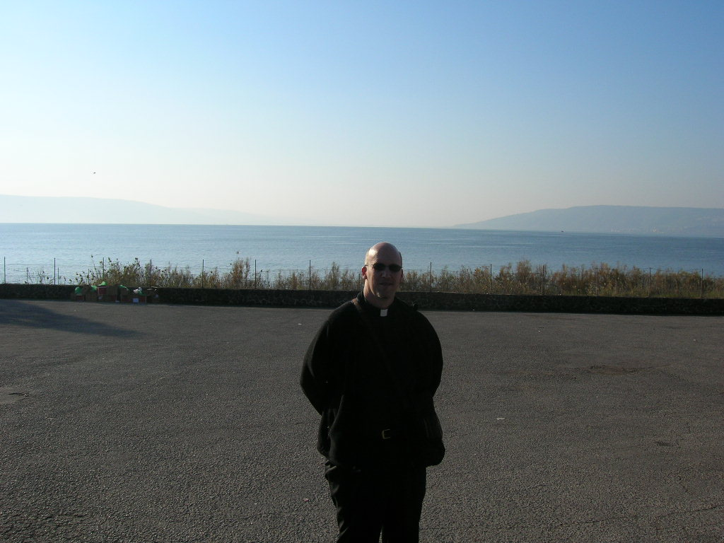
Yours truly in front of the Sea of Gallilee, or as you say in Israel “Yam Kinneret”. Kinneret is a harp, and the sea (actually a large lake,) is harp shaped. And yes, that is the far shore you see in the background. It’s not a huge lake/sea/whatever, though it is like paradise.

Slide 2
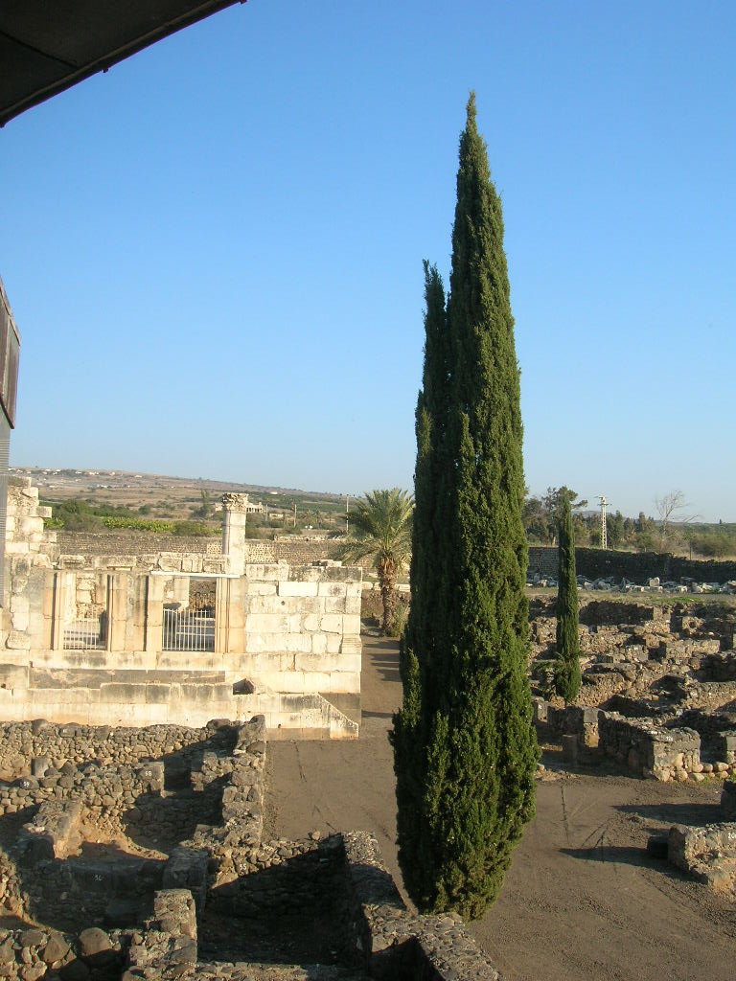
In Capernaum
This is an ancient synagogue from a little after the time of Jesus Christ. The remains around it are from the time of Christ. Peter’s mother in law was said to have lived in this area, and there is a Church built on that spot where we said Mass. Peter’s Mother-in-Law must have had a beautiful home, with a fantastic view.
Notes:
The

Slide 3
This is Fr. Phil, the other Priest who was on the trip, preparing for Mass. (We concelebrated all the Masses.) The Church is built over the remains of the house of Peter’s Mother in Law, who was evidently on the prosperous side as her home was built on prime real estate right outside of the synagogue. In fact, most of the homes and sites of the ancient Biblical figures pointed to a rather prosperous reality.

Slide 4
The Greek Orthodox Church in Capernaum. Every place which has a Roman Catholic Church and a Greek Orthodox Church side by side, bears witness to the continued tradition of the Greek Orthodox Church to beauty, and leaves one wondering why us Roman Catholics bother building such mundane Churches in such holy sites. I’m not complaining! I’m just saying, is all…

Slide 5
Capernaum is beautiful!
It overlooks the Sea of Galillee, and you can see every Biblical site mentioned in that area, from any shore of the sea you happen to be standing upon. In the background is Tiberias.

Slide 6
Yours truly reading the Gospel over the remains of the house of Peter’s Mother in Law. It was here that Jesus cured her and she got up and served everyone. The handrail in the foreground is an opening that looks down upon the remains of that home, which has been held as the actual spot since the time of Christ, and which is supported by archealogical evidence. (Archealogical evidence is very big in the Holy Land!)

Slide 7
More remains of Capernaum Needless to say, there are LOTS of remains in the Holy Land!

Slide 8
In the background is the home of the Franciscans in charge of the RC sites at Capernaum.
In the foreground are more ruins, this is an olive press, and surrounded by other ancient artifacts and columns. The olive press would have been powered by a mule or some such animal. They love their olive oil in the Holy Land. And I do too.
I’m not sure why I’m using bullets here, but hopefully we’ll get over that as this progresses.

Slide 9
This is our hotel as seen from, Capernaum. The hills in the back are where the zealots lived to avoid paying taxes to Rome. We saw and passed those hills for days.

Slide 10
When in Capernaum… we took a boat ride on the Sea of Gallilee, and of course the boatman threw out a net, and of course when it came back empty we all said to throw it on the other side, and of course it still came up empty because the fish have caught on after all these years and all these tours. Annette from Peter’s Way is in the picture as well. She wore a fur coat and dark glasses all through the trip and really helped glam things up. The Holy Land was freezing cold by the way, and very windy at times.

Slide 11
Moving up from Capernaum we approach the Mount of the Beatitudes, which is surprisingly close except for the fact that you have to climb uphill. In terms of Our Lady of the Lake, it would be like walking from the Church to Saiah’s grocery, if it is that far at all. Walking to Tiberius would be like walking to Madisonville, or maybe Covington. Wouldn’t you love to sit here and listen to Jesus tell it like it is?

Slide 12
From the Mount of the Beatitudes, looking toward Tiberius. The mounts you see in the picture are the cliffs where the Zealots dwelled to avoid paying taxes (again. I admit I was fascinated by them) Simon Peter was a zealot I think? His mother-in-law no doubt paid lots of taxes given her great real estate. No one ever mentions what became of his wife, though if Jesus healed his wife’s mom, we can assume that Peter’s wife was probably OK with everything that was going on.

Slide 13
The Church at the Mount of the Beatitudes. The Mount forms a natural amphitheater, and has a spectacular view of the entire Sea of Galillee (although just about everywhere on the Sea has a great view of the entire Sea!)

Slide 14
I am the very picture of piety on the Mount of the Beatitudes. I actually read the Beatitudes to the group after the guide recited the Lord’s Prayer in Aramaic. It was a moving experience. Directly behind me is the mount/cliff where the swine rushed over the cliff after the evil spirits went into them, which reminded me to pray for several people. There is also a huge Kaballah center on one of those hills back there which draws lots of Hollywood folk.

Slide 15
This is the Benedictine Church built where the miracle of the loaves took place.
There is a famous mosaic on the floor in front of the altar, and I’m sure I have a picture of it somewhere. It only has four loaves, because of course the ‘loaf’ on the altar is the fifth.
Everything here is loaded with significance, most of which escapes me at the moment.
I lit a candle for Ken Beck here, under the icon of Mary to the left in front.

Slide 16
This is a creche scene from the Miracle of the Loaves Church. I expected better creche scenes as we went along, however they all look about like this. They really need to reconsider their Christmas decorations in the Holy Land. We should form a committee?

Slide 17
Next stop on our whirlwind tour of absolutely everything we could possibly see or do in the short time span of ten days, was Cesarea Philippi. There’s not much to see there except, of course, more ruins. This is an ancient temple built to honor Pan, the Roman goat god. It’s built in a natural cave, btw, and used to have an actual temple in front of it. Cesarea Philippi is where Peter acknowledged Jesus as Lord, in the pagan part of the land.

Slide 18
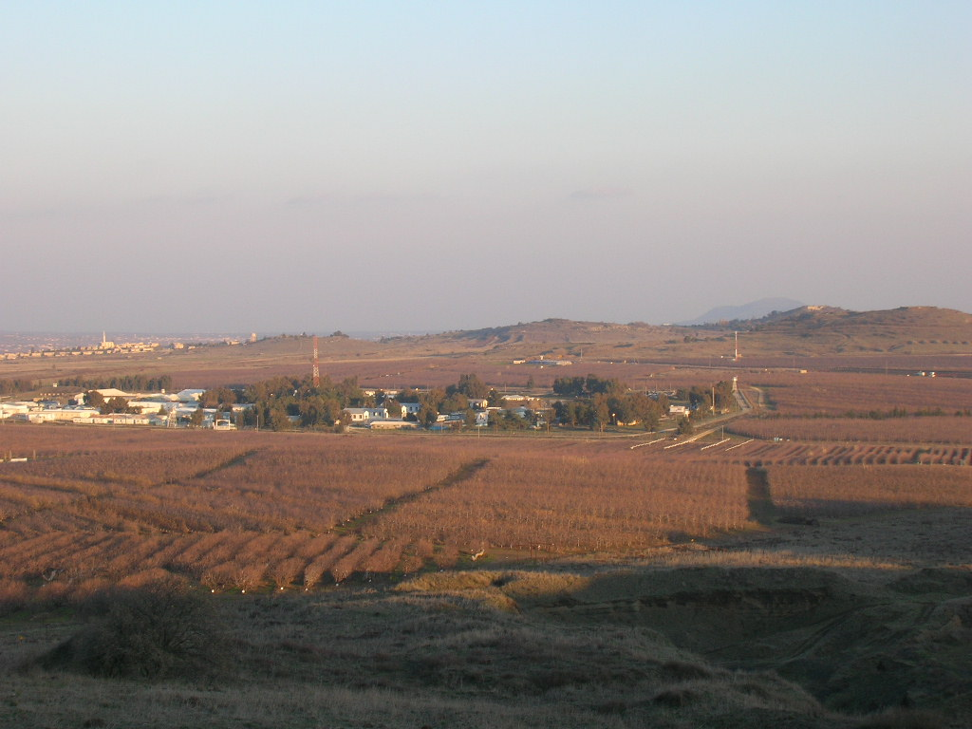
If you would like to see the road to Damascus where Paul had his conversion, you should definitely just fly to Syria and skip trying to see it from Israel. This is as close as you get, and it’s several miles away between the mountains which did not even come out in the photo. We are overlooking the United Nations Peacekeeping camp between Israel and Syria, and right under a huge military observation station which you cannot photograph. It’s not an extremely inspiring spot, though it does appear to popular with the locals or those on the highway who want to stop and take a break. (It was freezing cold here.)

Slide 19
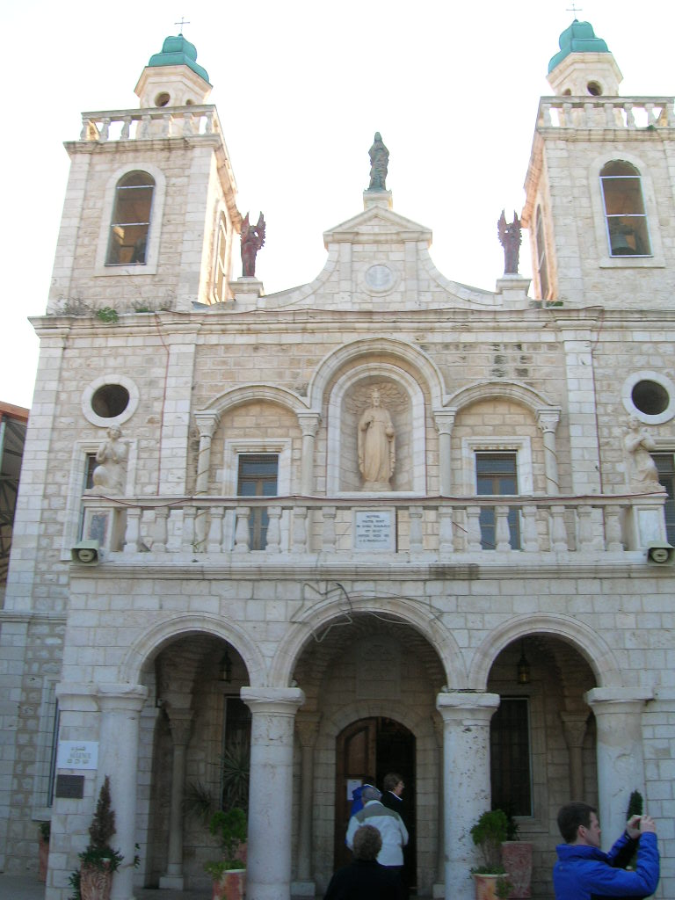
Ahhhh... Cana. The site of Jesus’ first public miracle. No one is really sure where that actually was, and new archealogical evidence points that it may indeed be somewhere else. But as our tour guide pointed out many times, tradition is often stronger than fact. There is a Greek Orthodox Church across the street from this, with about 1,000 empty wine boxes outside of it. We figured that they want to make sure they never run out of wine again!
Couples can, and often do, renew their wedding vows here and get a cool certificate.

Slide 20
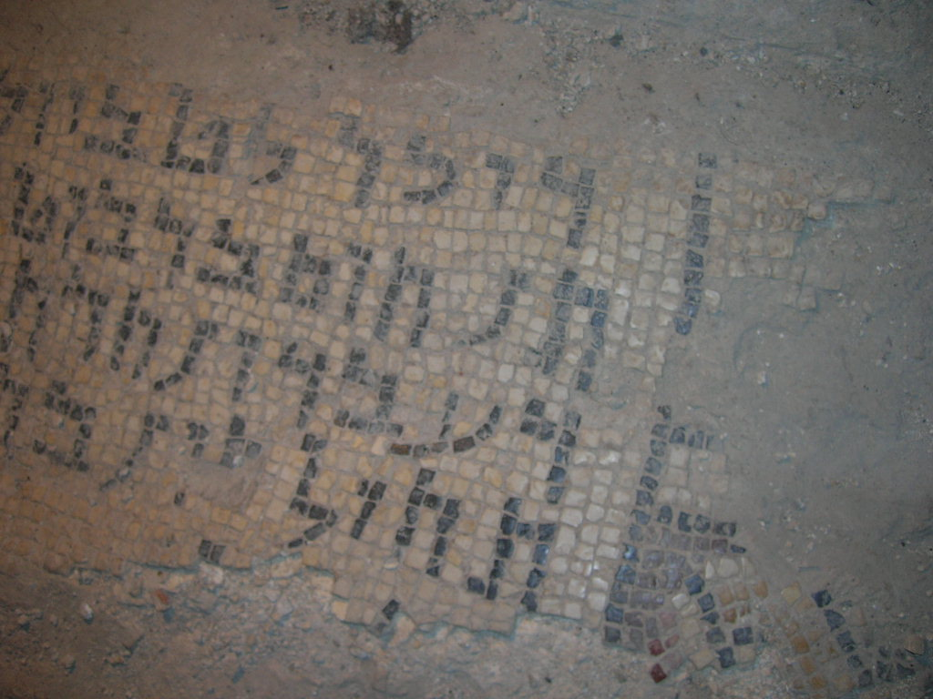
Queen Helena, who of course was the Emperor Constantine’s mother who traveled to and spent enormous sums in the Holy Land building Churches and shrines and whatnot, had these mosaics put into all the floors, and you often see them still. I photographed almost all of them, but that’s not really necessary in retrospect, as I don’t read ancient Latin, Hebrew or Greek. (I don’t even read the modern versions…)

Slide 21
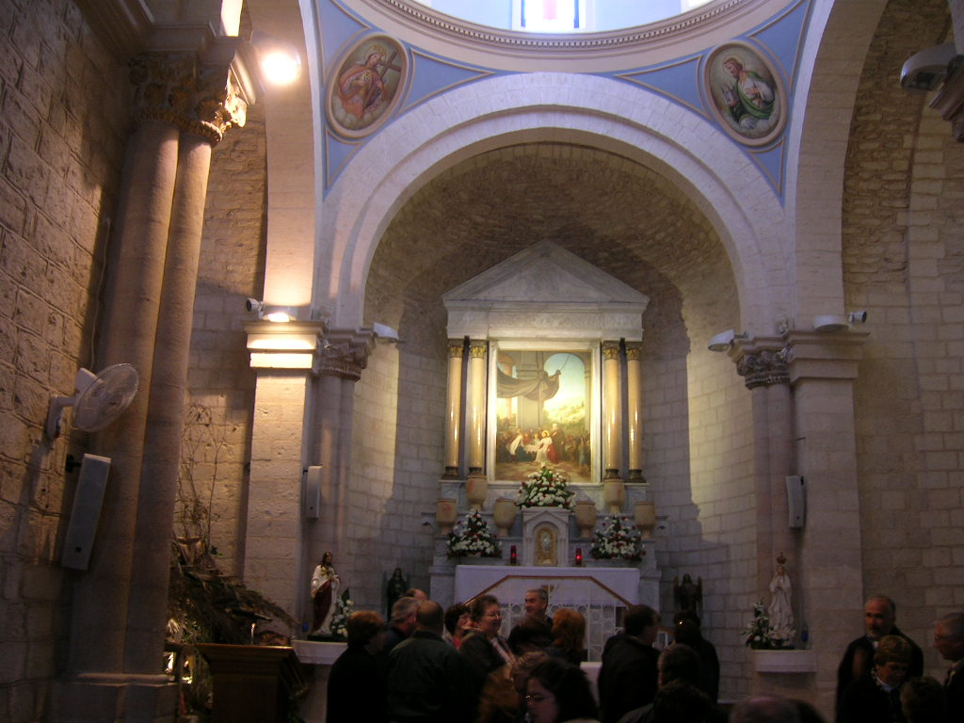
The pilgrim filled Church at Cana…

Slide 22
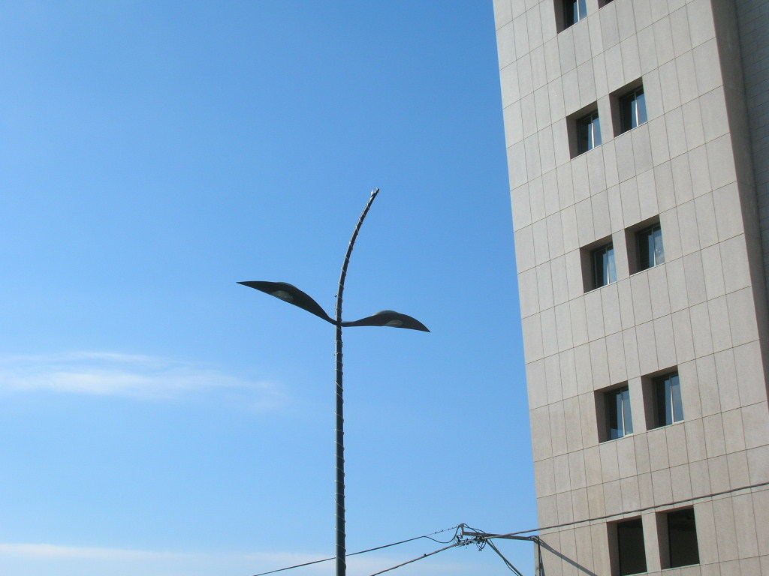
This just reminded me so much of the aliens from the 1950’s version of ‘War of the Worlds’, that I had to take a picture. It’s a street light in the ancient city of Nazareth. It also looks like Flipper, in a strange sort of way.
It’s stark modernity was initially humorous, though it ultimately forshadows the encounter with the very modern Roman Catholic Church at the home of the Holy Family in Nazareth, where the Annunciation is said to have taken place.
Everything in the Church is built to remind you of the shapes “BVM”.

Slide 23
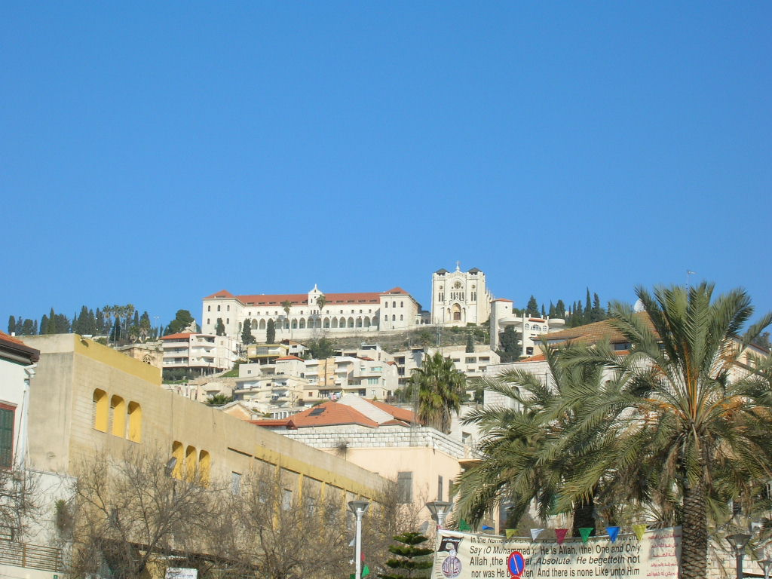
‘Ahhh…’ you think as you drive through Nazareth. “What a beautiful Church we’ve built to honor the Holy Family and the Annunciation!”
But no, this is actually a Salesian Church built on a hill in Nazareth, with an adjoining school.
There is an interesting sign in the bottom of the pic honoring Mohammed with the anti-Christian verses quoted, with a humorous traffic sign in front of it.

Slide 24
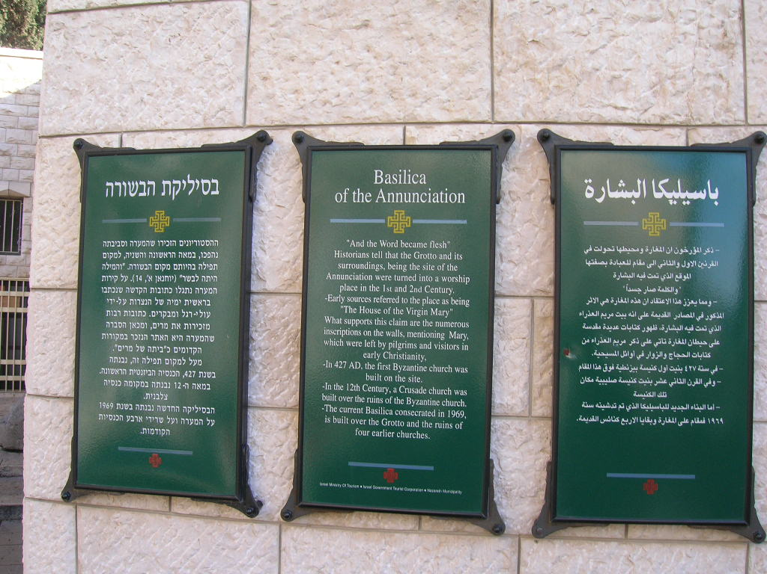
We’re here! At the Basilica of the Annunciation!
I can’t stand the excitement!
I can’t wait!

Slide 25
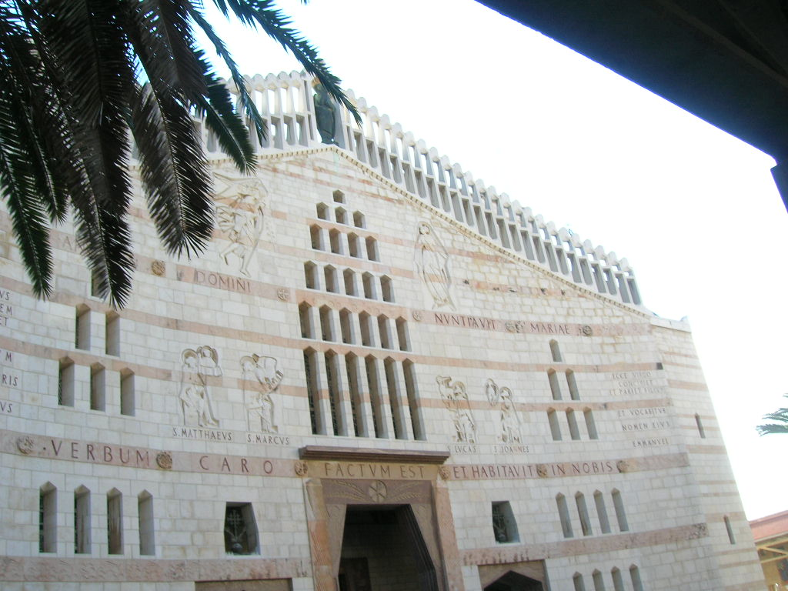
I’m guessing Helena did not build this one… I’m straining to see the BVM’s… I’m confused….

Slide 26
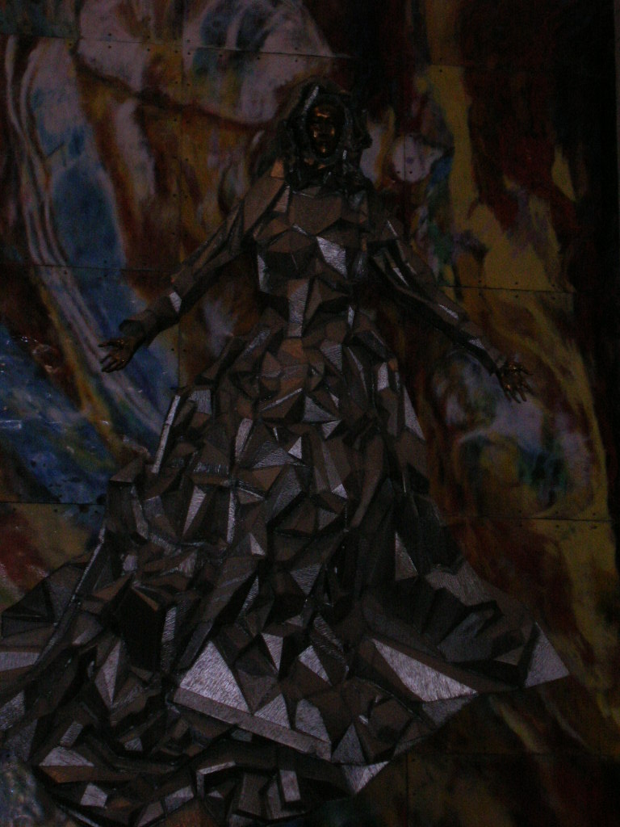
This lovely image of Our Lady graces one of the walls in the upper Church. It was graciously donated by the Church in the United States, and there’s a huge plaque letting everyone know how generous we are with our inspiring artwork.
We used to be ‘merely Michelangelo’ … now we have… this! It truly leaves one speechless.

Slide 27
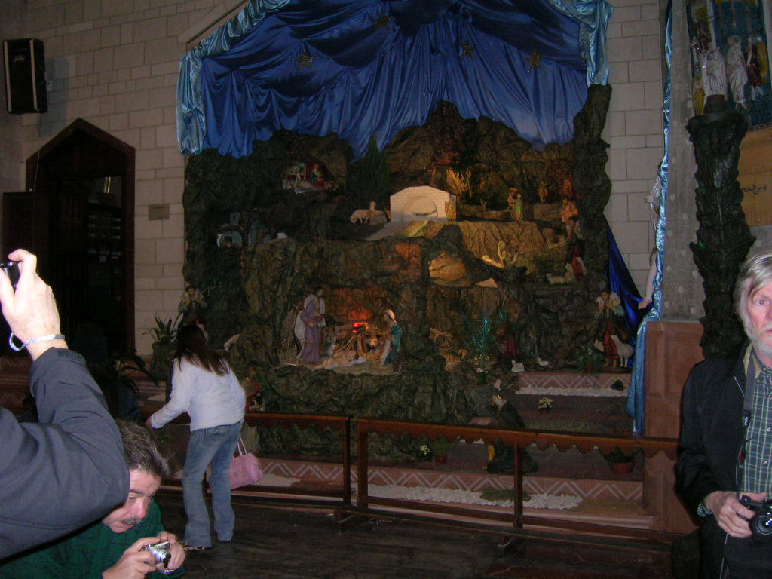
Everyone was similarly moved by the tasteful creche scene in Nazareth. You can tell they must have spent entire hours putting this together.
Everyone is clearly moved by it, even if they are all moving away and looking a bit stricken.

Slide 28
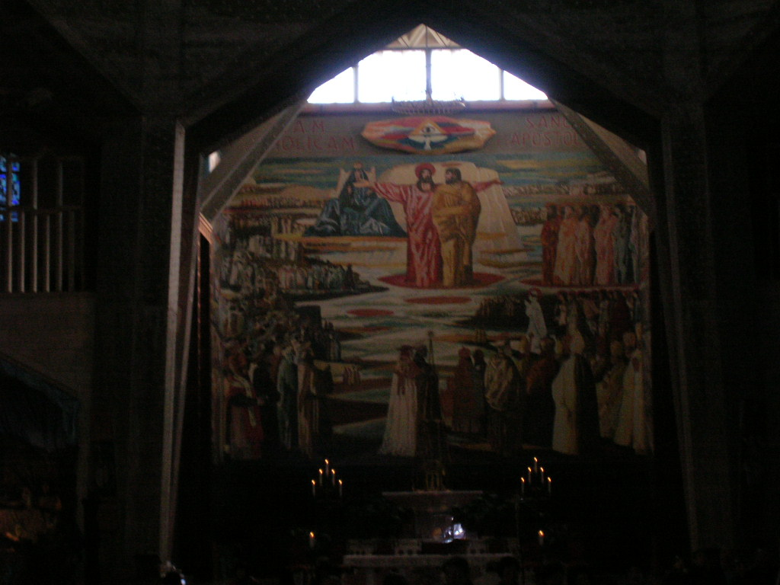
The mosaic behind the high altar is very large. Jesus seems quite pleased in the picture, as if in rapt admiration for the scene of the Church before him. I guess he is talking with St. Joseph? The Virgin Mary does appear to be sitting behind him, though I am not quite sure why her legs appear to be in an ‘M’ shape, like she is giving birth. The arch is in a ‘A’ shape, so it must be AVM, instead of BVM, that fits into the design model of the Church. (I don’t know why the cross is no longer an appropriate symbol for a Church…)

Slide 29
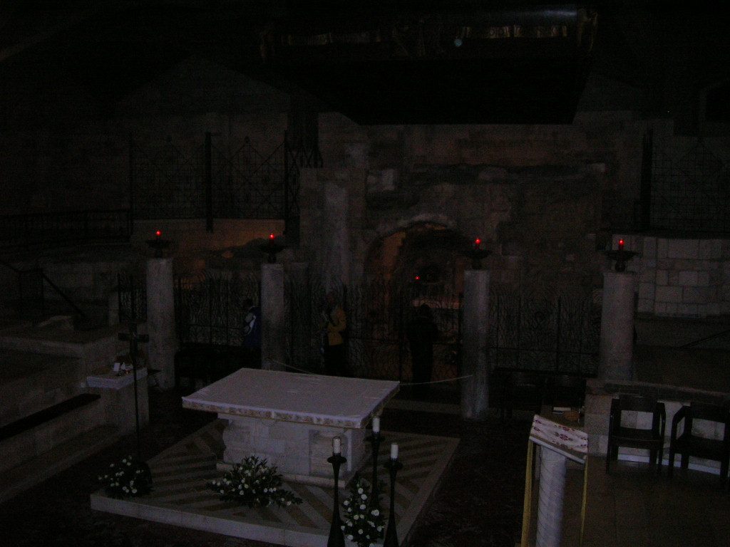
Because Jesus was a simple man, the crypt of the Church was left rather simple, in contrast with the heavenly glory infused into the Upper Church.
Here is a small grotto where the Holy Family’s home is said to have been, or where the Annunciation happened. Or both. (I’ve forgotten amidst the wondrous splendor.)

Slide 30
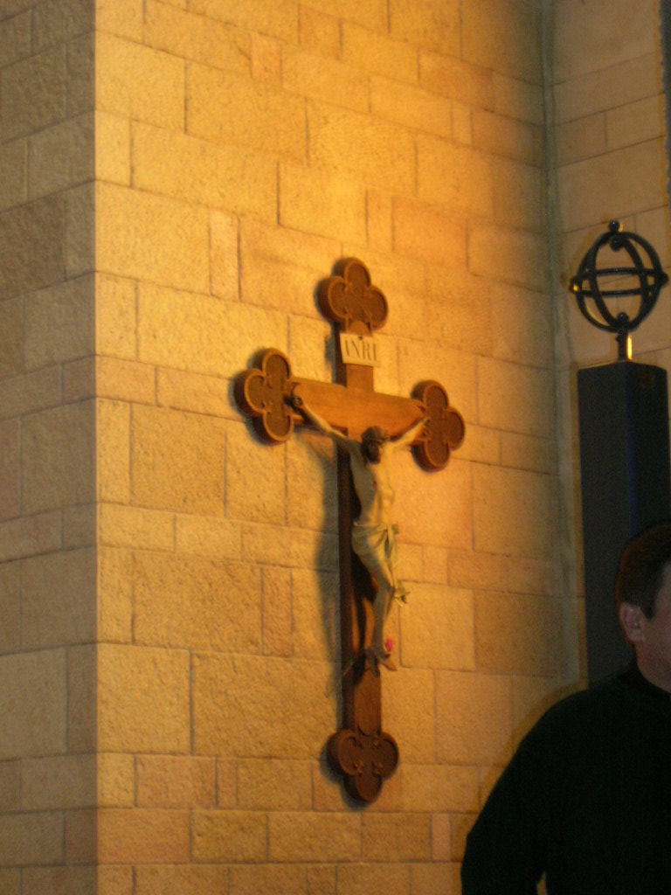
A beautiful crucifix in the lower crypt Church. Next to it is a black column with a gyroscope on top of it. In this particular Church I just chose not to ask…
We did attend Mass here, in the glorious and inspiring upper Church. It was completely in Arabic, and the music was, in truth beautiful.

Slide 31
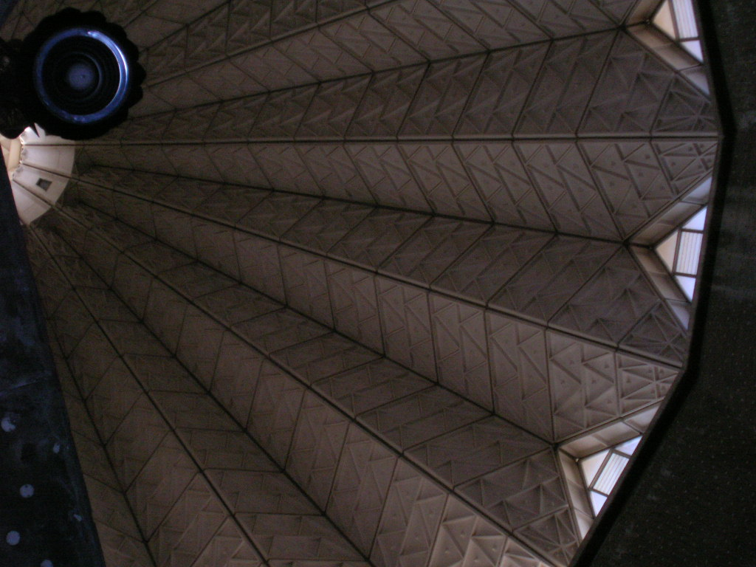
An inspiring view of the dome which crowns the Upper Church. You can make out all the little A’s, V’s and M’s.
Ave Maria!

Slide 32
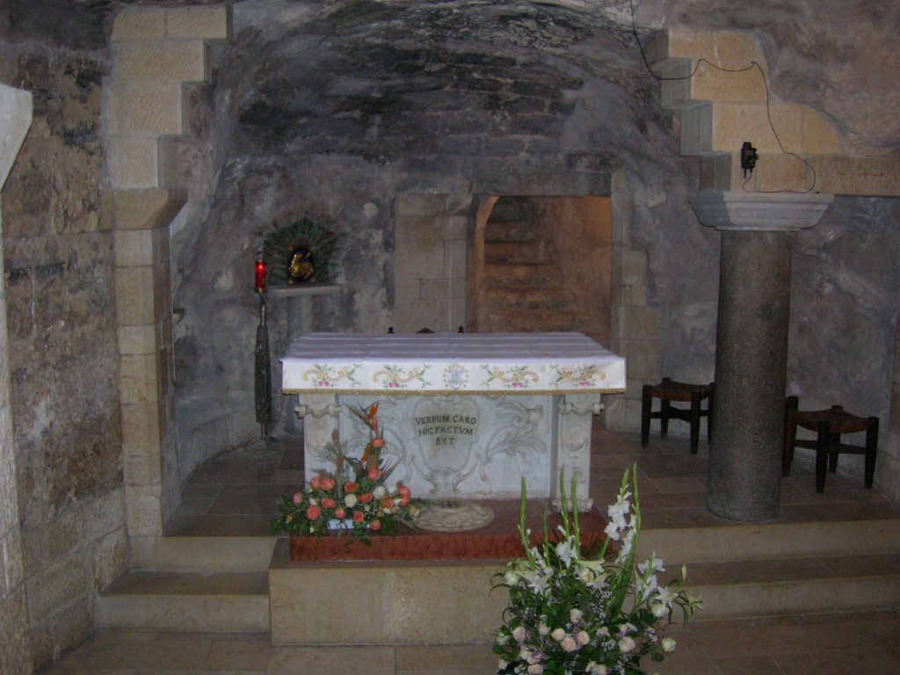
Oops, this is out of order. It’s the most beautiful part of the Church, and is inside the little grotto in the crypt Church, it’s where the Annunciation is said to have happened, and/or the Holy Family lived.

Slide 33
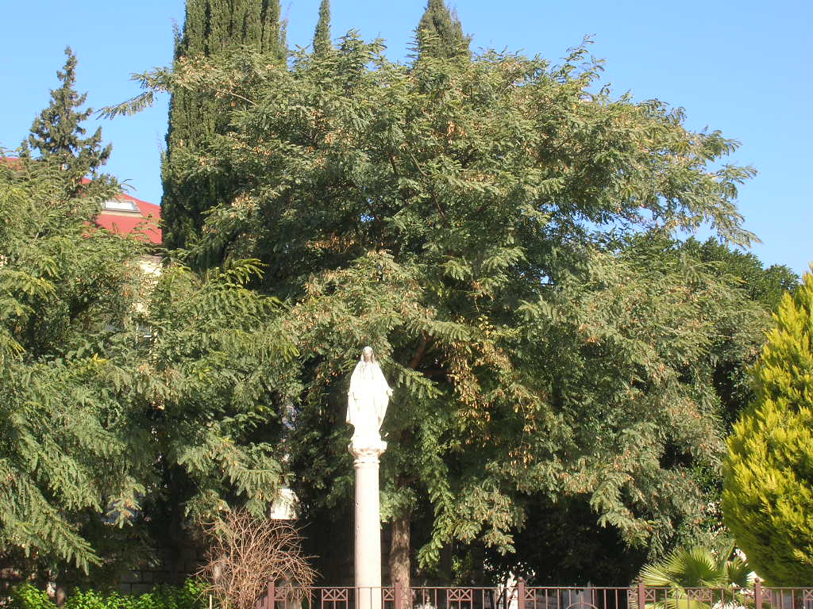
To a person we are thrilled to be out in the fresh air of Nazareth. Here is a statue of Mary amidst a small yet serene grove of trees.

Slide 34
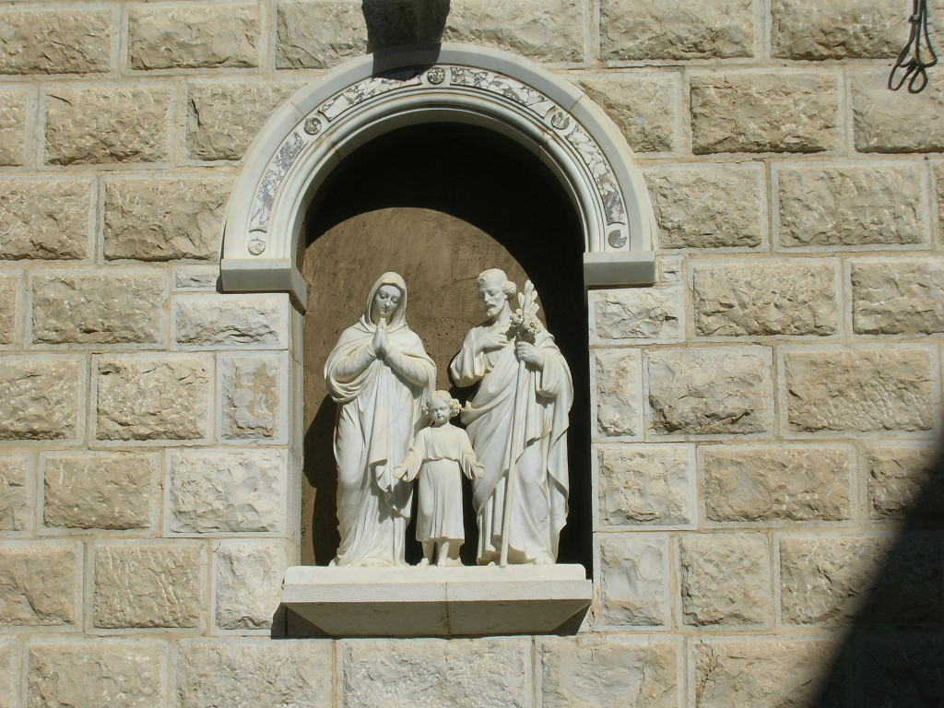
Next up is a great little chapel which is built over the remains of a carpenter’s shop. So of course it is a probable place where St. Joseph may have carried on his trade.
Interestingly enough, the word used in Scripture is not for ‘carpenter’ per se, but for someone who built wooden frames for construction, as opposed to tables and chairs and such. So he was more of an engineer than an interior designer.

Slide 35
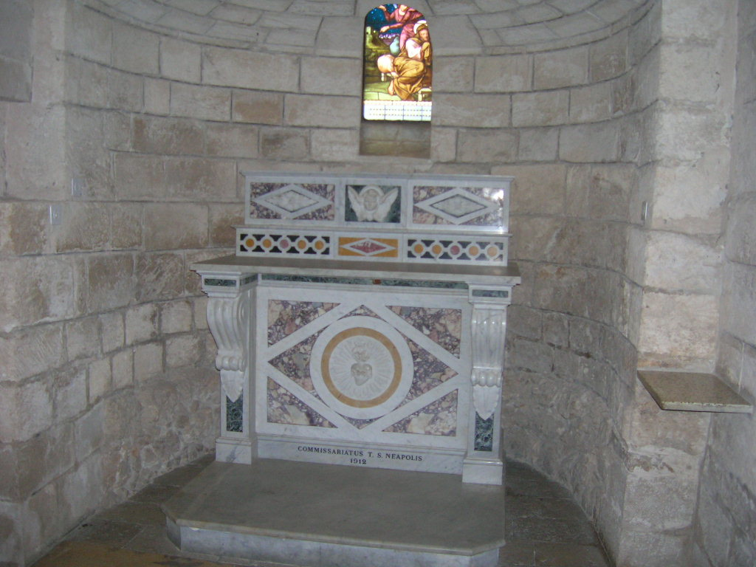
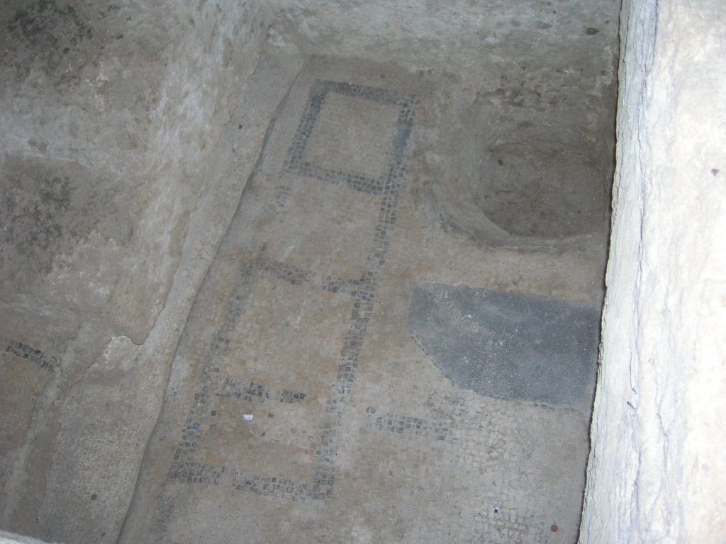
A small altar in the Church of the Workshop of St. Joseph. There was a Mass going on in the main altar, so no photographs from me on that one.
More Byzantine mosaics on the floor from the early Church built by Queen Helena on this spot way back in the day…

Slide 36
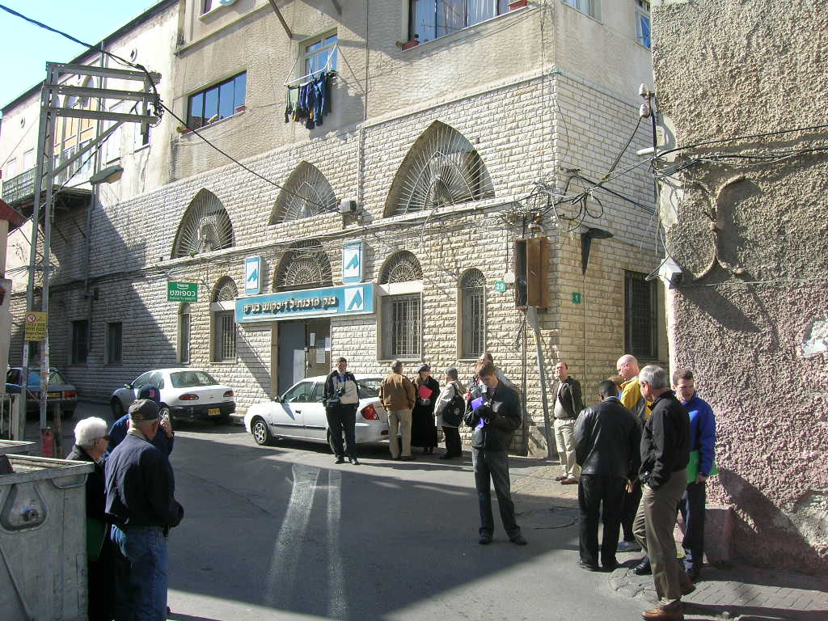
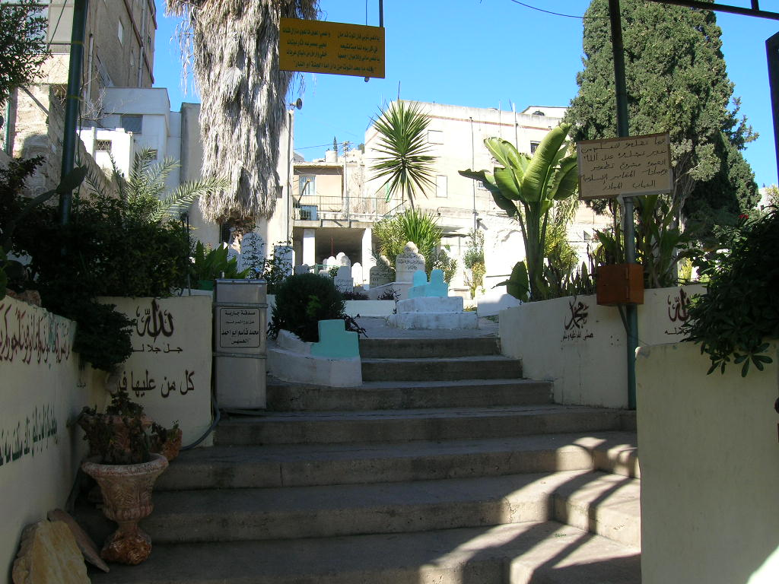
Street scenes… one of the group got lost and we waited in this spot while the guide looked for her for about an hour. She never lived it down, and it kept all of us (well, most of us,) on the straight and narrow for the remainder of the tour. We are all standing in the sun. (It was freezing there.)
Passing by this open gateway we noticed an Arabic cemetery. The only thing really interesting about it is that everything is written in Arabic, which is actually not terribly interesting, just a bit out of the ordinary for those not used to traveling in / near Arabic lands.

Slide 37
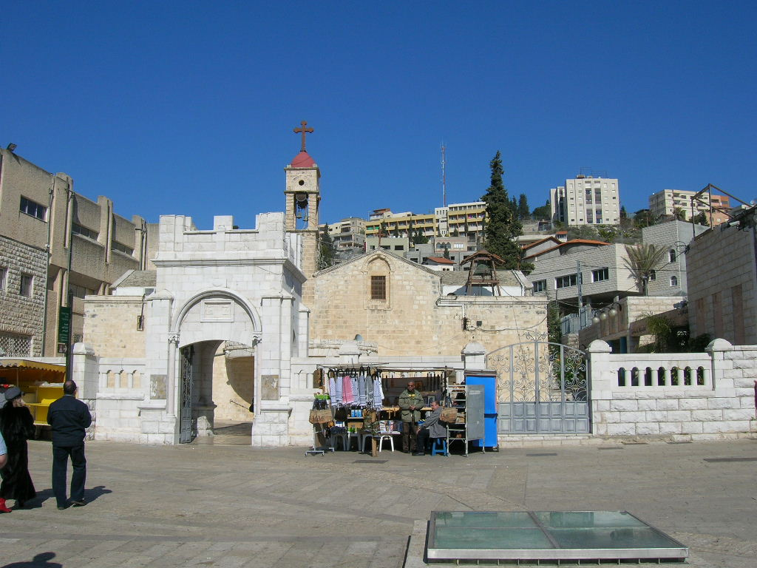
This innocuous building is built over the well at Nazareth. It’s the only well in town, so Mary would have been here fetching water in the mornings, sharing in with the joys and laughter of the other women, whilst Jesus played with the other kids. The guide always said the women gossiped, but since Mary was without sin, she could not possibly have gossiped. She must have been one of those people that you always feel inadequate when your around, but in a healthy way. Or something like that.

Slide 38
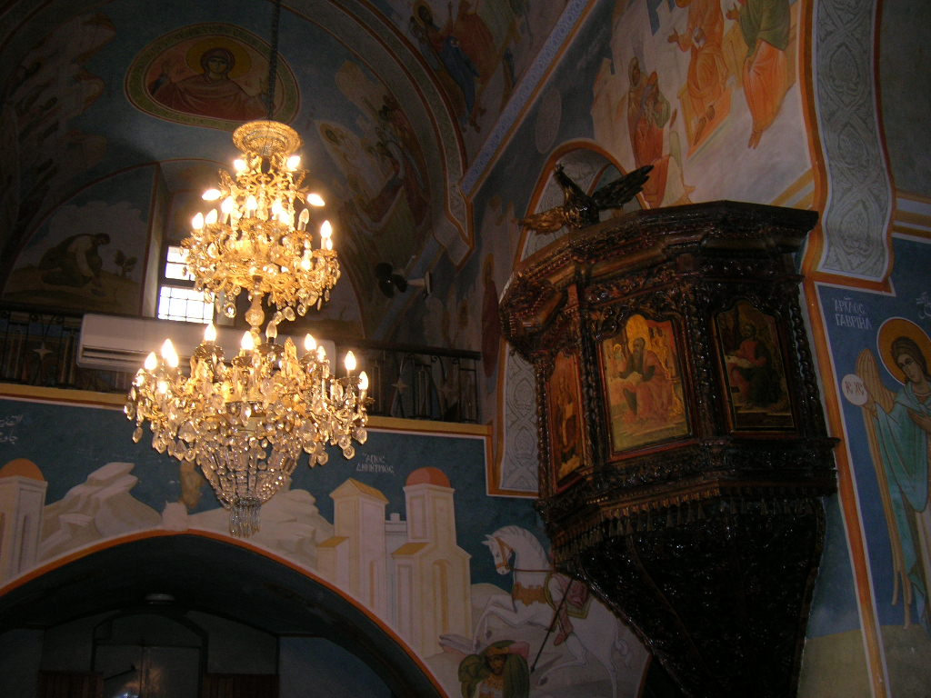
Inside the Greek Orthodox Church, built over the well in Nazareth.
Don’t you miss the splendor of the AVM motif throughout the Roman Catholic Church? And the glorious image of Our Lady donated by the Church in the US?

Slide 39
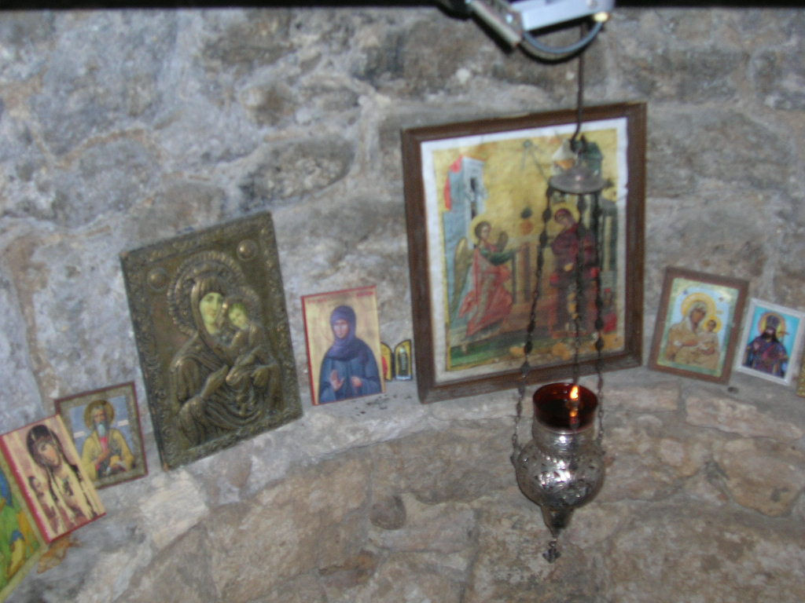
Just in case you
were wondering,
there is actually a well inside the Church of the Well.
It’s lined with icons.

Slide 40
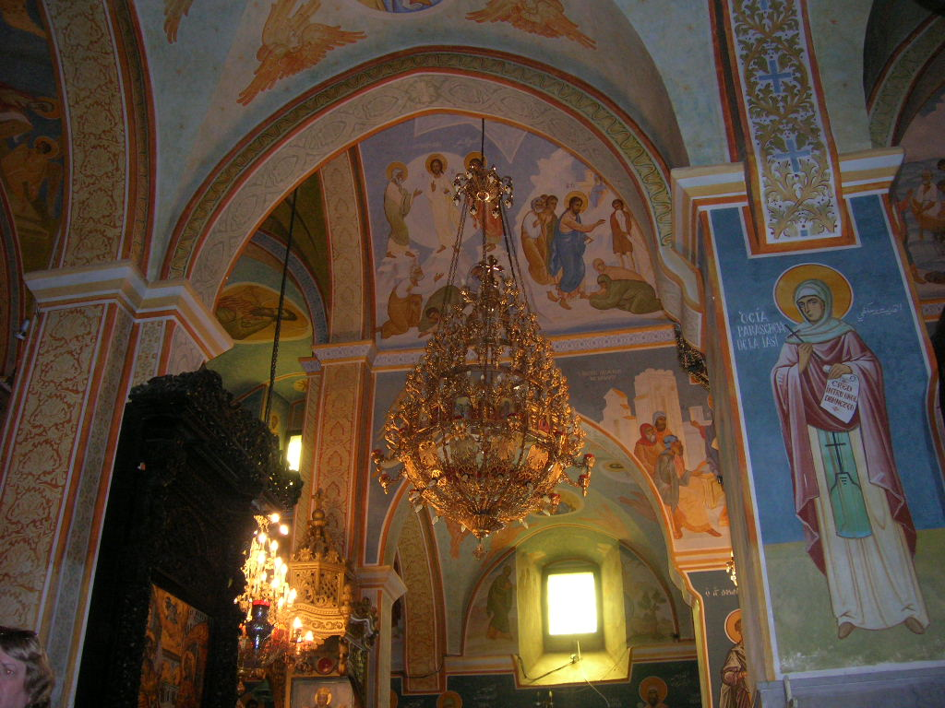
Silly Greeks. No Dome! Just a paltry chandelier!

Slide 41
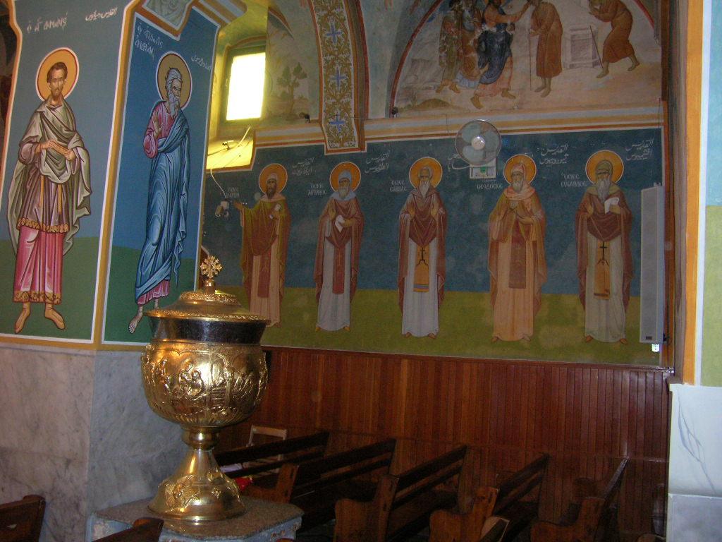
Though the golden Baptismal font is thoughtfully arranged with onlooking icons of the Apostles.

Slide 42
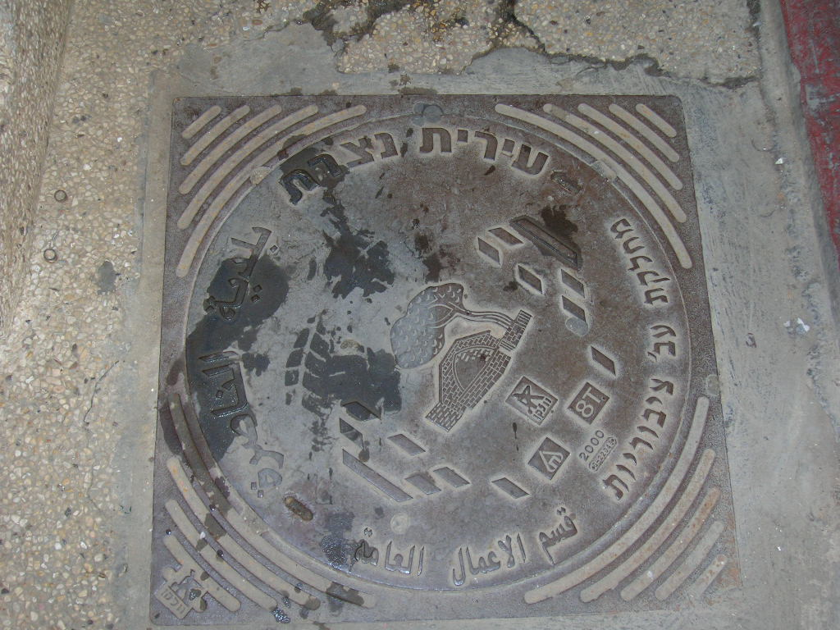
The sewer covers, which to my mind are a little too close to the well where little Jesus played, are written in Arabic and Hebrew. There is no shortage of water in the Holy Land and they use it with gleeful abandon, which is why the faucet splashed all over and you can see my sandal print on the sewer cover. (I thought of the New Orleans sewer covers which are now collector’s items.)

Slide 43
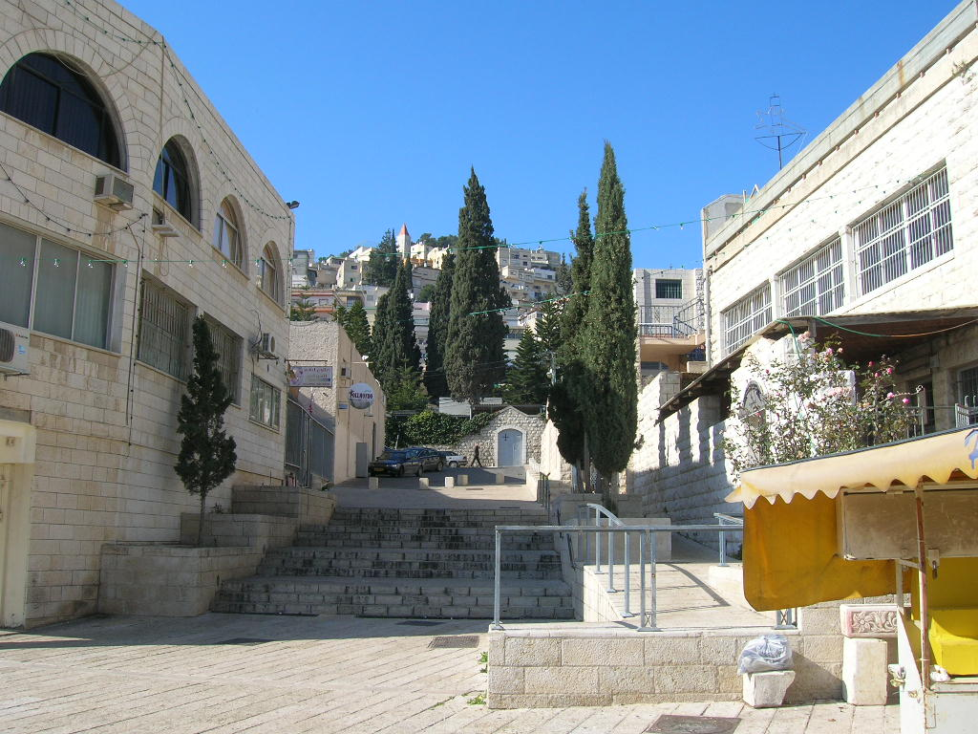
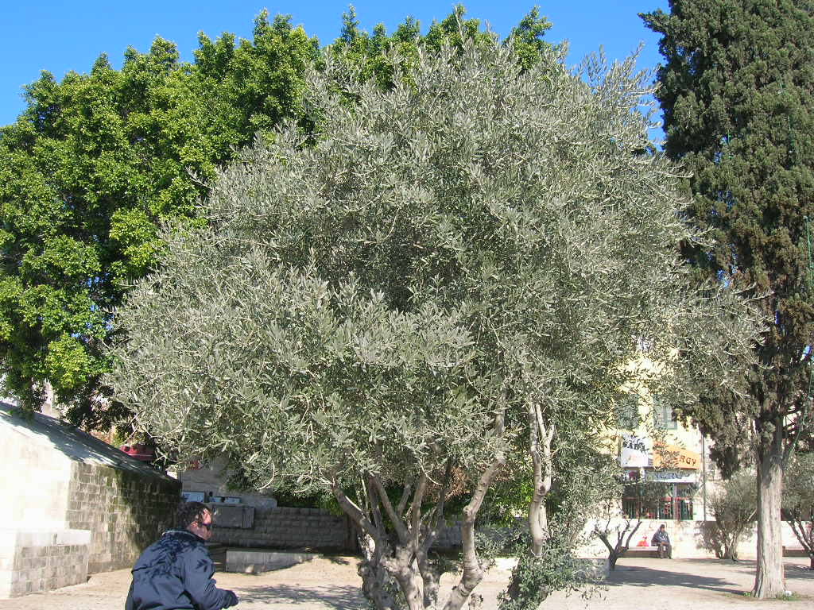
A typical street in Nazareth.
A typical olive tree in Nazareth. We took a branch off of this one to use at a prayer service we held at the River Jordan later that day.

Slide 44
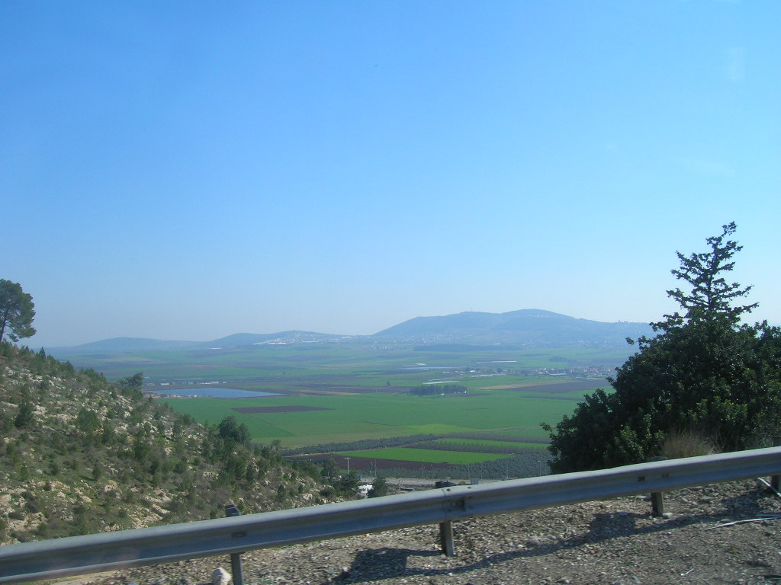
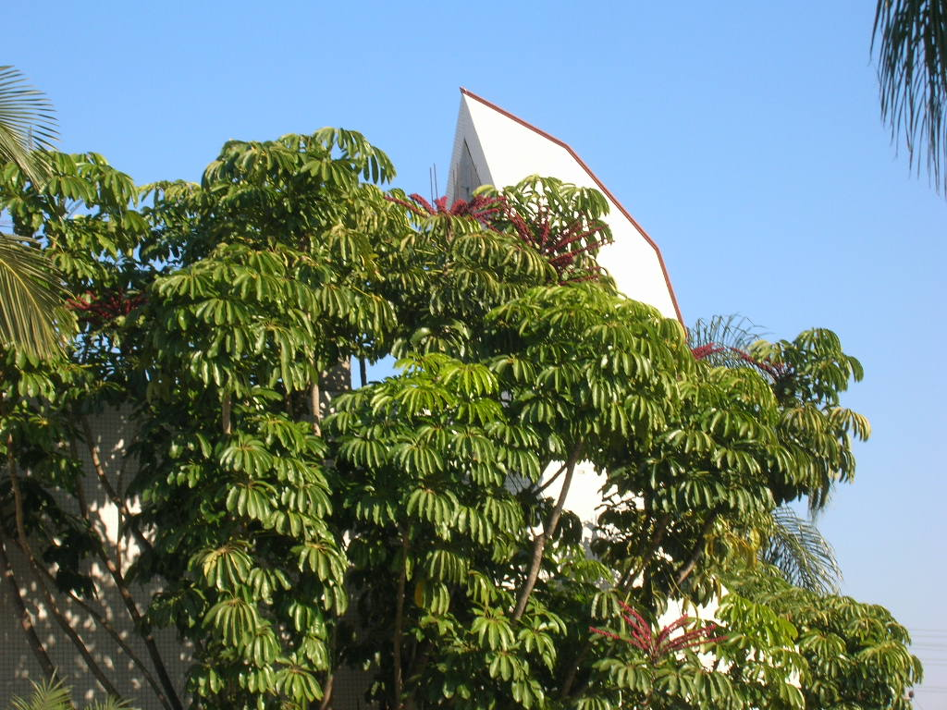
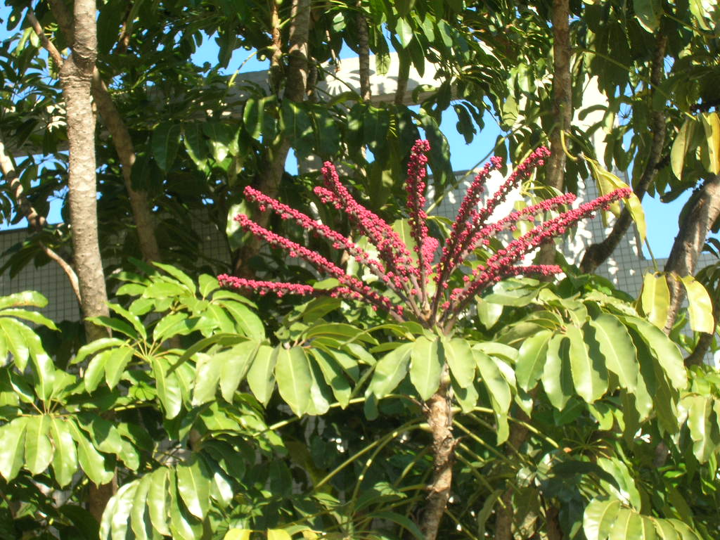
The Jezreel Valley, where a lot of battles and things happened, including where King Josiah died, and some Crusader battles. It’s the ‘bread basket’ of Israel, fertile, beautiful, and centrally located to boot.
A thirty foot tall schefelerra, which was blooming!

Slide 45
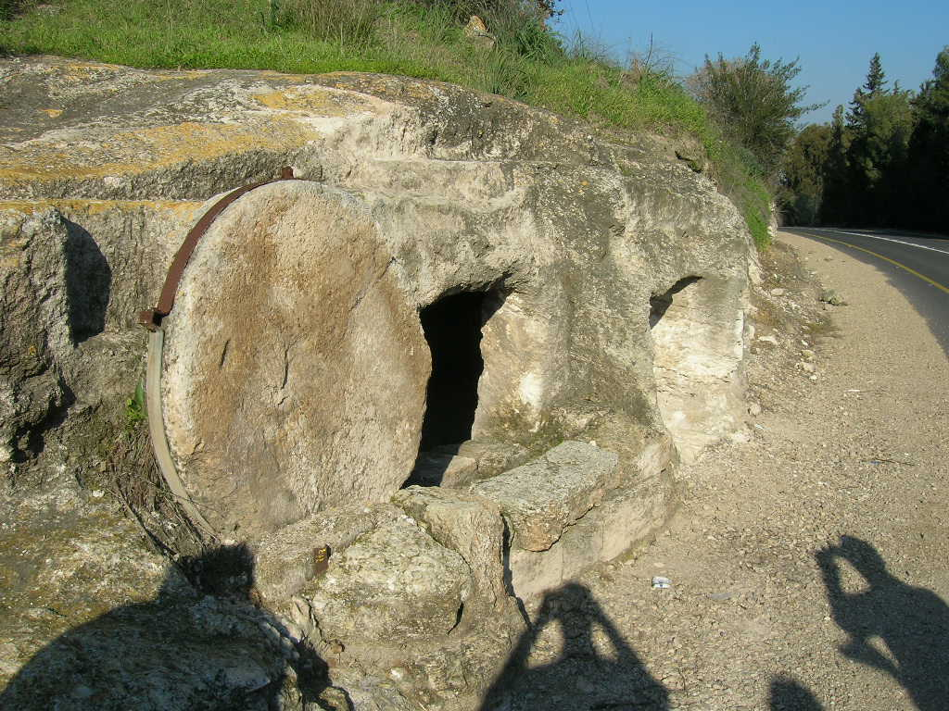
This is a typical ancient grave which was discovered with the rolling stone still intact. It’s right on the highway, so it could not have been terribly difficult to discover.
It gives a better idea than the one in the Holy Sepulcher, which is covered over by glorious shrines, and… a dome.
(Can you tell which shadow is mine?)

Slide 46
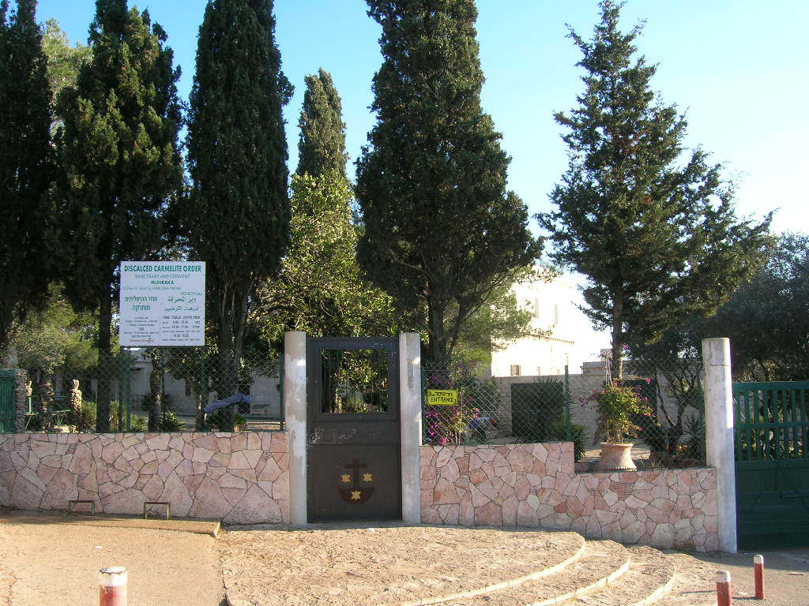
This is the top of Mount Carmel, which has a Carmelite Monastery on it. Imagine that.
The Monastery was closed to visitors as it was a Sunday. Normally you can go up on top and look at the magnificent view.
(It was freezing up here.)

Slide 47
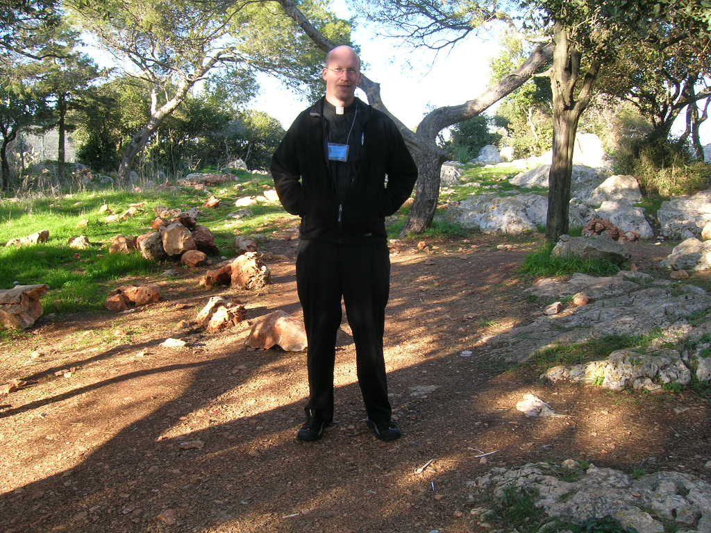
Yours truly atop Mount Carmel. It’s a relaxing spot, one can easily imagine why Elijah was attracted to the place. It’s hard to imagine living hereabouts and thinking that you were kicked *out* of the Garden of Paradise.
On a separate note, after looking at this picture I ditched the name tag. Everyone was just calling me ‘Father’ anyway.

Slide 48
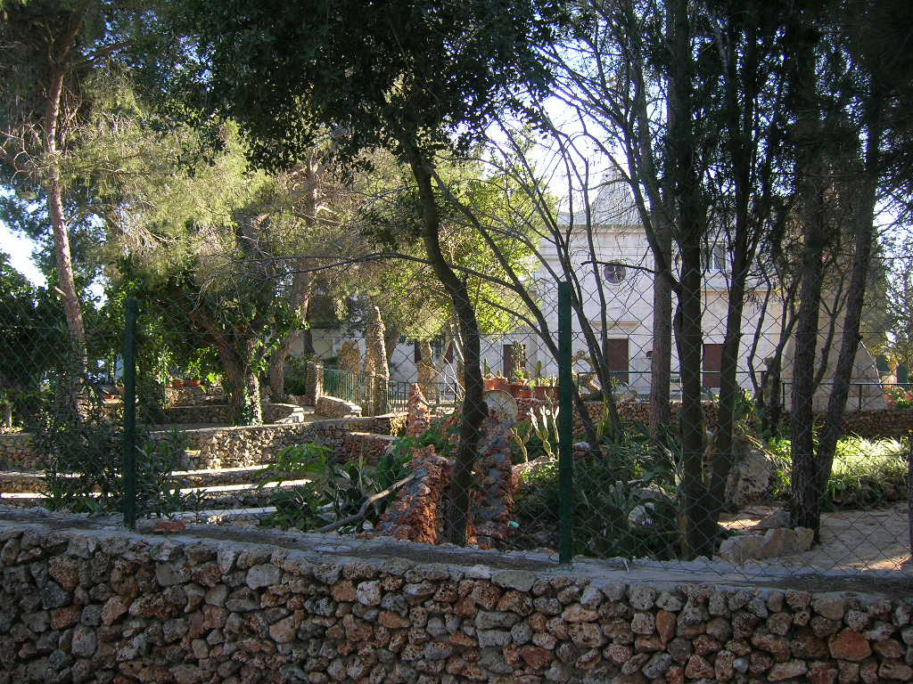
The garden at Carmel.
OK, it’s not the Garden of Paradise, but with a little planning it easily could be much closer.

Slide 49
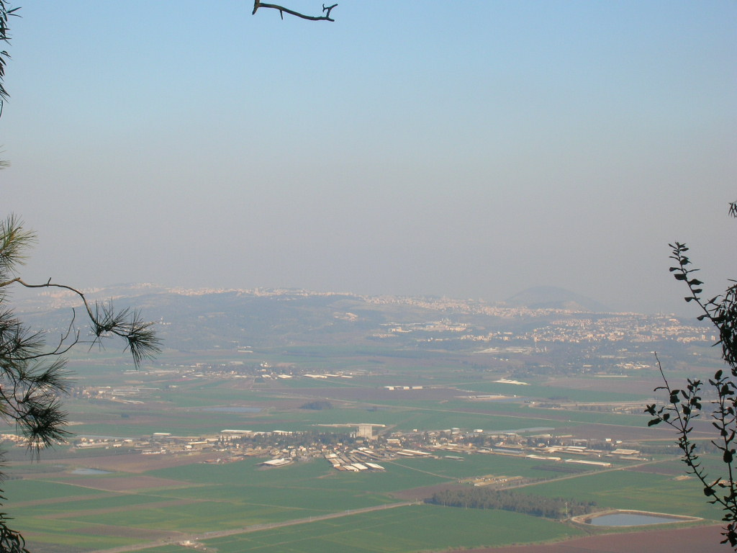
One of the views from Mount Carmel; the Jezreel Valley, Nazareth, Deborah, and a few other towns as well. That domed mountain dimly visible is significant… It’s very important; I must look that up again at some point.

Slide 50
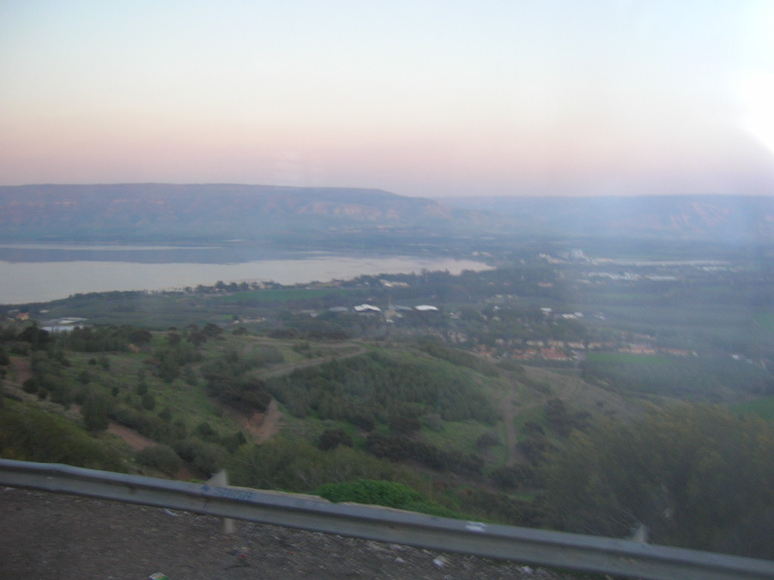
Driving back, the south side of the Sea of Galilee, heading to the River Jordan. The guide mentioned that when winds came from the South, from the higher elevations, it interacted violently with the warmer air currents and caused huge storms, with waves up to two stories tall. Not quite Lake Placid, but good to think about with the story of Jesus calming the storm.

Slide 51
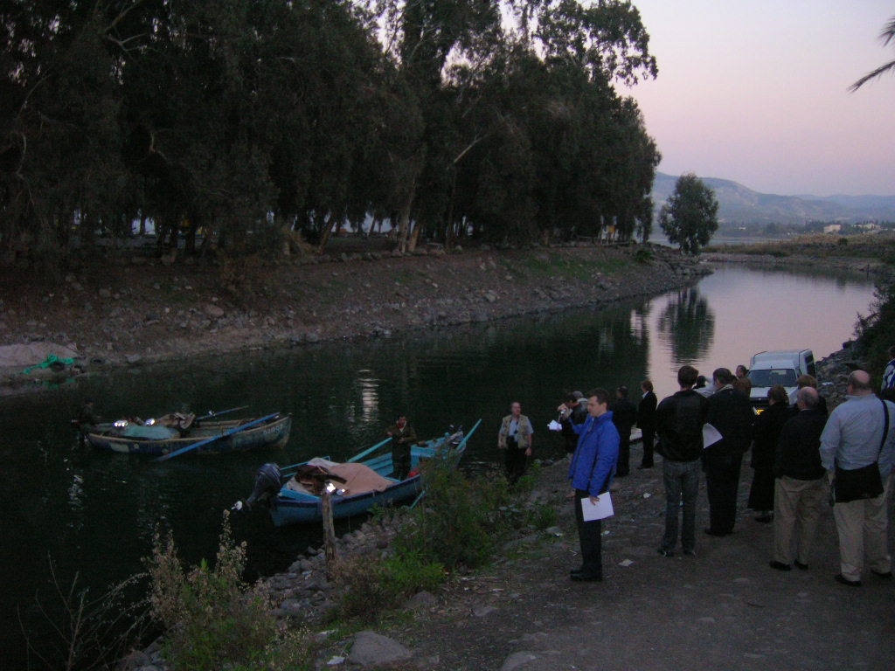
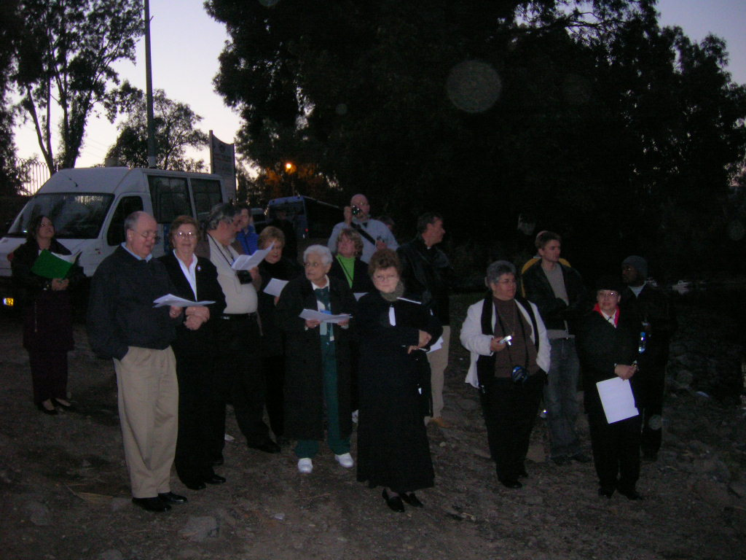
The River Jordan, which to my mind was just a polluted bayou type thing with very green water, had everyone but me collecting samples in ‘to go’ bottles. We had a prayer service while these typical Galilean fishermen got ready to go fish. Jesus certainly did call the ordinary, the workers, the salt of the earth.
Some of the group in a photo taken through water droplets from the river which are on my camera lens. It was moving to be by the River Jordan on the Feast of the Baptism of the Lord. The actual spot where John baptized is in a military area near Jerusalem and Jericho, and is inaccessible to the public.

Slide 52
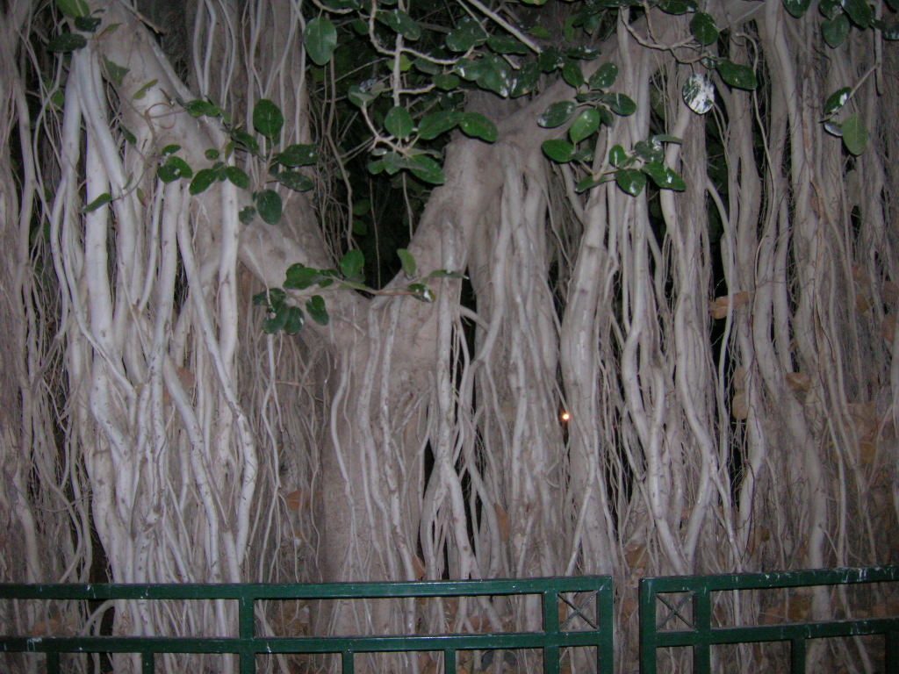
An interesting looking banyan tree in Tiberias.

Slide 53
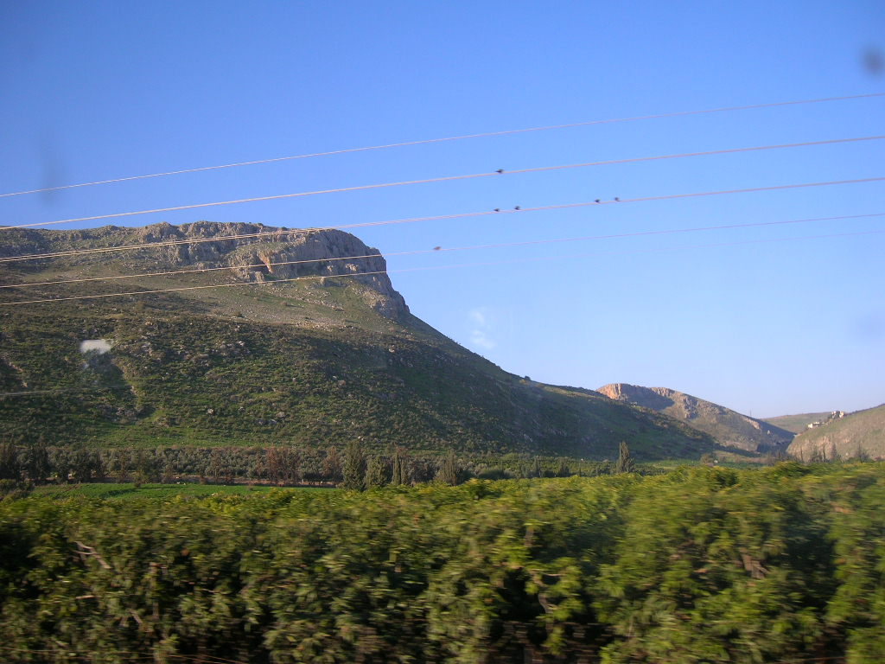
Again the caves where the Zealots dwelt. You pass any number of amazing historic areas constantly. We are now leaving the Northern Kingdom of Israel, and traveling the ancient 5-day route to the southern kingdom, Judah. It’s all Israel nowadays. Except for the west bank of the Jordan located within Israel, which is known as the West Bank, or the occupied territory, or Palestine, or as a generally confusing situation.

Slide 54
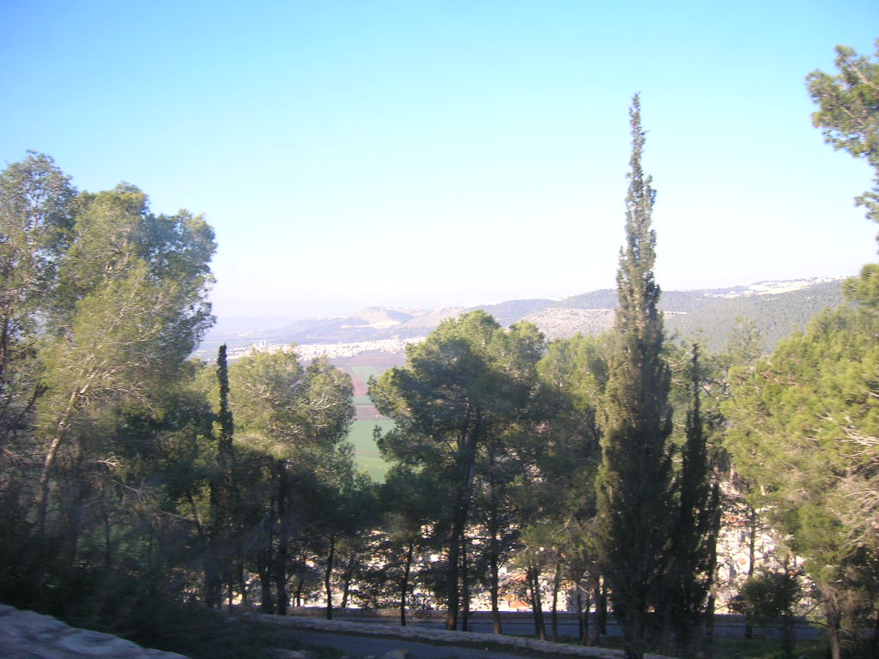
This is a beautiful view of something. I believe it is on the way up to the Mount of Transfiguration.

Slide 55
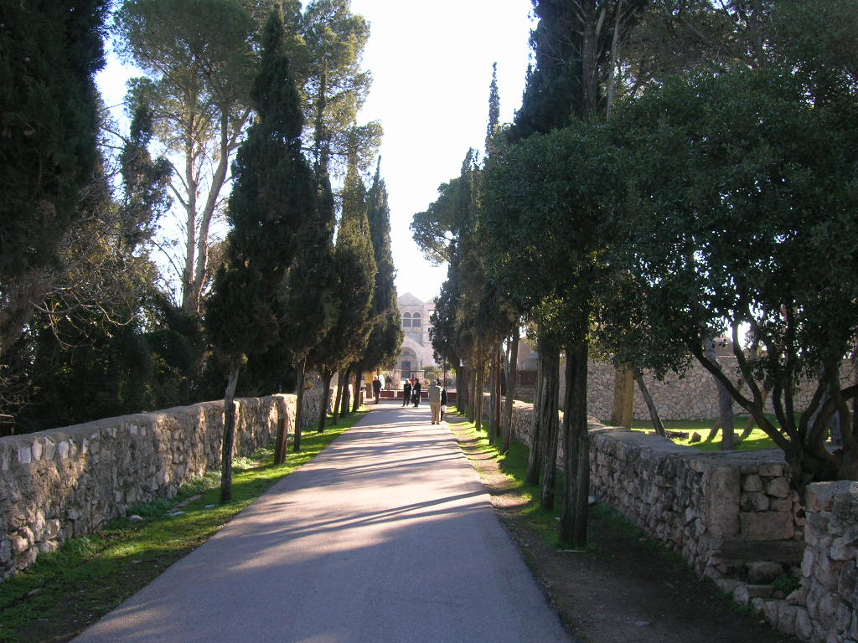
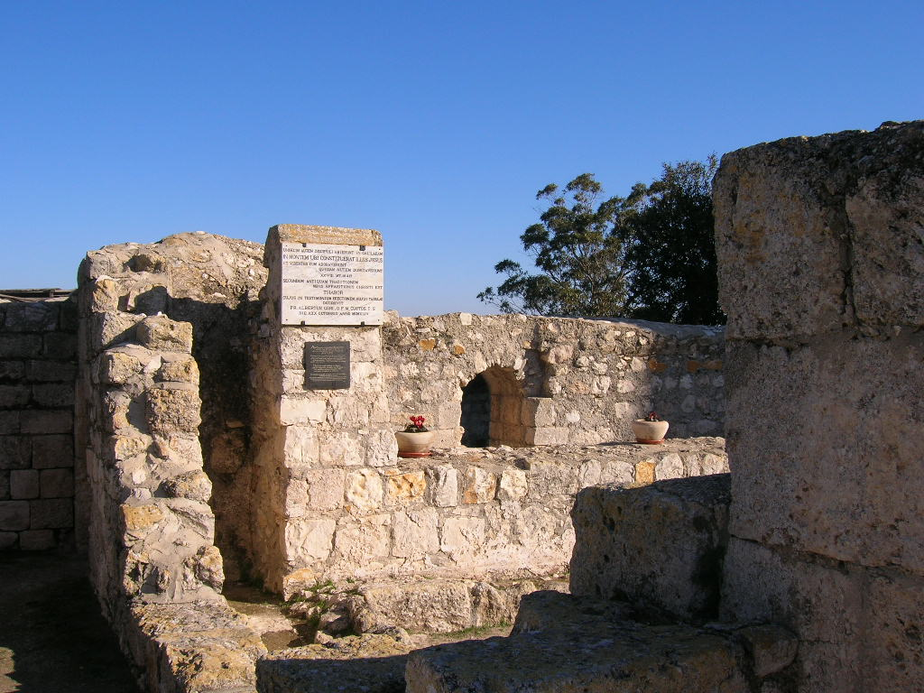
Ahh, yes it is.
Approaching the Church on the Mount of Transfiguration
Crusader ruins on the Mount of Transfiguration. As much as people complain about the Crusades, they were obviously failures…. It’s only ruins left from them, with mosques almost everywhere.

Slide 56
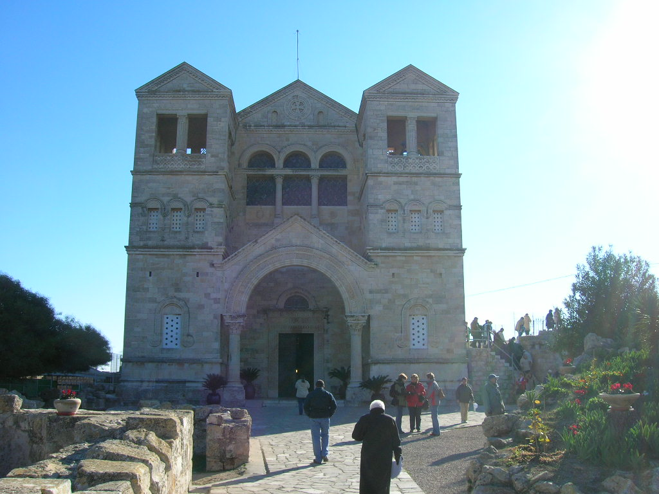
Peter wanted to build three tents, so there are just about three of everything up here. Obviously for the Trinity, but also because of Peter’s ‘three tents’ desire.
Three pinnacles on the roof here, with three arches…

Slide 57
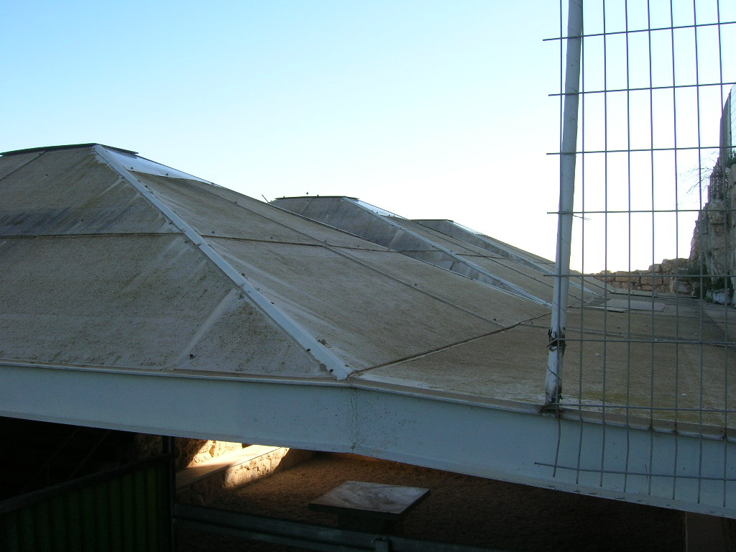
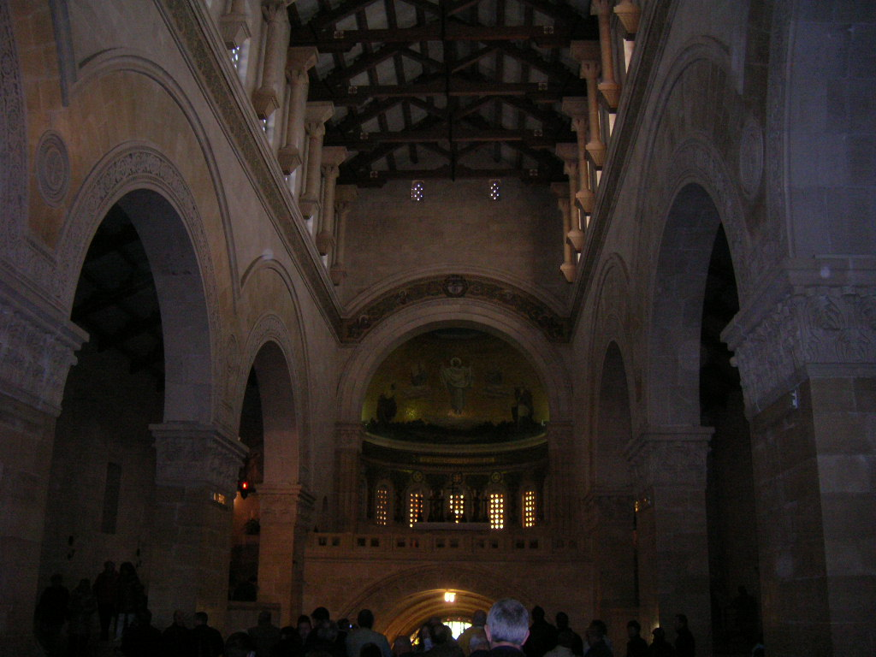
A little pilgrim’s shelter from the freezing cold, biting wind, with three tents! (It was freezing up there.)
The Church has three chapels, three big side arches, etc, etc, etc. A group was saying private Mass in the main Church so we did not get too close.

Slide 58
The Lord teaches us here that if you’re going to Transfigure, why not have a view? No wonder Peter wanted to build three tents… he probably wanted to stay there forever.

Slide 59
The obligatory shot of ancient Byzantine floor ruins…
Byzantines were simply Roman Christians, by the way.

Slide 60
We had an insane cab driver on the way down, who had been driving cabs to the top of the Mount for 50 some odd years. He was 79, and we told him we hope he didn’t have a stroke anytime soon. He spoke little English, trilled his tongue at a huge volume instead of using his horn, was strange peculiar and hilarious. He earned his tips for sure.

Slide 61
We traveled south through the Judean desert and marveled at the blooming fields (just like the brochure said we would!)
Before we left I had read the travel warnings, and was very relieved we were not going to the West Bank area.
So you can imagine my surprise when we crossed into the West Bank area.
Who knew?
A typical West Bank check area from the bus window (you don’t take photos of them, you know.)

Slide 62
The view from the bus of the check point on the road down to Jerusalem. This was a dangerous route in Jesus’ day, and they would have traveled in caravans with men in front, women and children in the middle, and men in back. Mary would have done this traveling to visit Elizabeth, and the Holy Couple when on the way to Bethlehem. Jesus, being twelve, could have been with either the kids and women, or the men, which explains why Joseph and Mary did not really realize he was missing at first after the visit to the Temple. (I was glad the tour guide distracted us with this information.)

Slide 63
This is the electrified fence built along the border of Israel and Jordan. I don’t know why it’s over there and we’re over here in Israel in occupied territory. Or is it just the “West Bank”? It’s a strange situation and gives you a headache if you think about it too much. After the Sea of Galillee, the river comes out to the east of you, so you are on the west bank of the Jordan River.
Our tour guide was a Palestinian Christian, and we always got an earful about the entire situation, though it did not help to understand it any better. I don’t think anyone actually understands it.

Slide 64
This is an Israeli settlement in the West Bank. It’s best not to get your Palestinian tour guide started on the subject of Israeli settlements that he is helping subsidize with his taxes. Though we did learn a lot about the situation from a Palestinian point of view, and he is an extremely intelligent and well informed tour guide, who I’d happily recommend anytime.

Slide 65
From Jericho, a view of an ancient Greek Orthodox monastery built on the hillside (to the left,) with a cable car running up to visit it (which you can kind of see…) At the top is where the Franciscans started to build a Church, but due to political conflicts decided not to, so it remains an abandoned limestone base.

Slide 66
From Jericho, out towards the Jordan River where John would have
Baptized Jesus, and where Moses would have said farewell to Joshua
As he brought the people into the promised land.

Slide 67
Unsurprisingly, archeologists no longer want to work in Jericho. Before they departed they uncovered this 8,000 year old structure, which is said to be the oldest ever found on earth. (Can you tell which shadow is mine?)

Slide 68
Ancient walls of Jericho, which may have been some of the ones to have come tumbling down….

Slide 69
There is no end to the touristy sites in the Holy Land. Here a site is made out of a sycamore tree, like Zachaeus would have scrambled up in order to see Jesus better. Zachaeus must have been a spry kind of guy.

Slide 70
When in Palestine…

Slide 71
We finally made it back into Israel proper, climbed 3300 feet, and passed into Jerusalem. This view is not a view while climbing up, it’s from the back of the bus after climbing up and turning a corner around the Crusader walls.
In olden days, while walking up to Jerusalem ‘a city built on a hill’, you would sing or pray the ‘Psalms of Ascent’, (Psalms 120-134.)
I was very glad to be out of the Westbank! Tense it is.

Slide 72
We then immediately crossed back into the West Bank, which is where Bethlehem is located. I came to realize the West Bank is a country itself, aside from being a hotly disputed area. Our guide kept anxiously asking us to put our cameras away.

Slide 73
One of the best places to see a typical ancient type cave like the one where Jesus would have been born is at the Bethlehem YMCA.

Slide 74
The view has probably changed in the last 2K years….

Slide 75
But the trees are quite lovely.

Slide 76
This is what your typical manger would look like, except it would not be broken into two or three pieces. Carved of the limestone which is all over the place, it held food or water for the animals, and of course it also held the Baby Jesus way back when...

Slide 77
Some caves had their own carved stairways. They were ‘split level’ caves, and the part the family lived in was called the ‘Inn.’
Gives a new twist to the ‘no room at the Inn’ line. Or an old twist, depending on how you look at it.

Slide 78
You know, every picture you see of the Holy Land has this bland washed out look to it. It’s much more colorful in person. This is looking toward Jerusalem from Bethlehem, over the fields where the shepherds would have watched their flocks by night (in the spring, not in December!)

Slide 79
A comforting sign adorns the local mosque, across the street from the Church of the Nativity.

Slide 80
Across the street from the Church of the Nativity and the local mosque, at the Peace Center, there’s a big picture of Yasser Arafat wishing everyone a Merry Christmas! Yessir Yasser! The entire Clinton family was here with Yasser for the Grand Opening of the Peace Center.

Slide 81
Ahhh, the Church of the Nativity. We were gently reminded that 23 or so terrorists, who to some are of course freedom fighters and heroes, holed up in here a few years back. We also learned that to the Romans, the Zealots and Maccabeeans were considered terrorists.

Slide 82
Again, I really think they need to re-consider their Christmas decorations in the Holy Land. This is the (very tiny) entrance to the Church. You bow ( a lot!) as a sign of respect.

Slide 83
One approaches the door to the Church in solemn reverence. And too, with a bit of trepidation.

Slide 84
The Greek Orthodox section is very lovely, and filled with ancient art and such. They were chanting and smoking incense in the front, and then the Greek Orthodox Priest (GOP?) walked all around the altar chanting before going behind the icon screen to finish Mass.

Slide 85
One of the columns has this cross in it, you can put several of you fingers in it and say a prayer, then kiss the column. It’s a strange tradition, but I did it anyway. What happened is that one day the Church walls started to fall down, and the Virgin Mary appeared and held the Church up by holding this very column, and her fingers left this cross mark in the column! (The tour guide seemed to think someone drilled the holes. Oh for the gift of Faith.)

Slide 86
Here is some of the ancient artwork , barely visible at the top of one of the ancient columns.

Slide 87
The Greek Orthodox love their lanterns. Calvary actually looks a lot like this as well. The modern space heater to the left is because it was of course freezing in here. (It was freezing in there.)

Slide 88
This is the entrance to the underground cave which used to look very similar to the one at the YMCA. There is a huge silver star on the floor down there where Jesus is said to have been born, and it looks down at the actual spot. A group of Korean tourists who showed up everywhere we went, all took their pictures with their hands on that very spot. It was very well coordinated. I do have to say though, that I think having digital cameras takes away a bit from the reverence due the place. (It obviously did not stop me from using mine, but I did stop to pray also.)

Slide 89
The ancient marble steps down to the cave….

Slide 90
Ancient marble work and ancient icons adorn the entrance…

Slide 91
Lanterns and pilgrims are everywhere!

Slide 92
With all the pictures I took, it would have been nice to get an actual shot of the very place where Jesus was born.
Also the beautiful side altar where the manger is said to have been. Sadly I did not do either one as I was busy praying for everyone.
At least I was praying, so it’s not sad after all. Especially in such a joyous place.

Slide 93
You arise from the cave and enter into the Greek Orthodox sanctuary again, here seen in all of it’s incense filled splendor.

Slide 94
Here is another shot, just because I thought it looked really cool. There’s even an ancient ladder to the right to help refill all of the gazillion oil lamps, which must be a full time job for some patient soul.

Slide 95
You then enter immediately into the Church of St. Katherine (of Alexandria), which is where we said Mass. I presided and it was a very moving experience.

Slide 96
Here is where I lit the candles for everyone…

Slide 97
One of the underground chapels very near to where our Lord and Savior was born….

Slide 98
The Church had a great Sacristy, (and wonderfully clean restrooms.)

Slide 99
They also had two organs. This one behind the Sanctuary which we used for Mass, and another larger one in the back. Wouldn’t it be nice to have this kind of setup at OLL?

Slide 100
This beautiful tapestry is right at the entrance to the Sacristy. It’s unfortunately torn, but still photoworthy.

Slide 101
After Mass we exited into a beautiful plaza and wondered why we didn’t just enter in by that route. There’s a star on the Church right there, and for the record, the stars in Bethlehem could be revisited along with the other Christmas decorations. The strange cacti on either side of Mary are bit bizarre as well. (I am *so* un-middle-eastern…)

Slide 102
A small orange tree in the courtyard gardens…

Slide 103
This is one of the two Bethlehem checkpoints. Evidently a portion of Jerusalem is in the WestBank as well, I later learned.
Our tour guide did not like our hotel, which was entirely kosher, and preferred one run by his Palestinian friends, which was actually just about the same. However, I would not trade the view from my room for any other! It looked right onto the old city of Jerusalem, onto the Temple Mound.

Slide 104
Yours truly on the balcony.

Slide 105
At first I thought the cemeteries were cool, then I realized they are absolutely everywhere. Something to do with the verse from Ezekiel about those being raised first who are buried near the Temple gates. In olden days you were considered unclean after touching a tomb, so they were whitewashed, so that while walking around at night you would not bump into them. ‘White-washed sepulchres’ is how they were known.

Slide 106
To the left is the Al-Aqsa Mosque atop the Temple Mount. It has amazingly cheap loudspeakers and the call to prayer is whiny, loud and irritating (it’s the same everywhere.) In the video clip I sent from the Western Wall you can vaguely hear it in the background as a whiny high pitched buzz. Directly in front are ruins (go figure) of an ancient palace built by some pashah or sheik or something.

Slide 107
The entrance to the Temple Mount. If you are not Muslim you can only enter through the Dung Gate. So very kind of them. You cannot bring a Bible or have any type of devotional items showing (crosses, rosaries and such.) I did wear my clerics of course. While on top they send people over to listen to what the tour guide is saying, and you can’t really wander about and spend a lot of time up there. It’s open about 3 hours a day to non-Muslims.

Slide 108
On the way up to the Temple Mount you can look through the rail and see the Western Wall. It used to be called the Wailing Wall, but it’s a more gentle and less offensive name these days. It’s the portion of the original Temple Wall which was closest to the Holy of Holies.

Slide 109
Once up top the scene is fairly serene. The Dome of the Rock is not a mosque, but an Islamic shrine built over the rock that Abraham is said to have been about to sacrifice Isaac. It’s also the rock from which Mohammed is said to have ascended into heaven and been shown around before returning to further his causes in Islam. It’s built in an octagonal shape, so that means it was originally built by the Byzantines, since that is not a Muslim design, at least at the time this was built.

Slide 110
Being atop the Temple Mount is a moving experience, however there is also a bit of tension in the air. The muslim guard came and sat near us, and kept smirking at us. The arabic inscriptions around the top of the Dome of the Rock are all about God having no son, etc. Jews are not permitted (by other Jews) to go up to the Dome of the Rock site, as they might wander into the area where the Holy of Holies was and hence desecrate it. A few weeks ago some orthodox Jews circled the Dome and were followed by security the whole time. I summised they were pulling the Jericho routine on the Temple Mount.

Slide 111
The water in the fountain was frozen! (It was freezing up there.) Note the group in the background huddled close together. That’s about how you do the Temple Mount when you are not Islamic.
No one who is not muslim is allowed in the Dome of the Rock, so we spent a brief time on the plaza individually contemplating the hideousness of the entire situation, and then snapped some photos and left. Not much else to do up there if you don’t want to get arrested. To clarify, the current situation was evidently sparked by Prime Minister Sharon a decade or less ago, who insisted on visiting the site and making big deal about it, which caused tensions and security issues. Then a Christian minister with a Bible went into the Dome of the Rock and tried to burn it down… Sharon currently has one of the multi-million dollar spreads (one of many) in the Old City, and it is located in of all places… the Arabic Quarter.

Slide 112
A lovely view atop the Mount.

Slide 113
Lots of minnarets looking over the Arab quarter of the old city. It is not a racist statement to note in passing that the Arabic Quarter of the old city is absolutely filthy. You cannot help but notice it.

Slide 114
More views of the old city top…

Slide 115
One of the gates leading off of the Temple Mount down into the Arabic Quarter. Note the armed guards in uniform at the gate, along with the sleeping bum who is probably security in disguise.
If you convert to Islam you can enter this gate any old time and not have to enter through the Dung Gate like we Christians.

Slide 116
A street vendor starting up the day in one of the old streets. I thought these were all alleys until it finally dawned on me they are the actual streets of Old Jerusalem.

Slide 117
A look down a side street, (strewn haphazardly with trash.)

Slide 118
And then we ended up back here. For some reason I have many pictures from this exact spot, of exactly the same thing. We are looking over to the Mount of Olives.

Slide 119
In fact, here is the Mount of Olives. It is almost completely covered in graves. For about $20,000 you too can be buried in the Holy Land. I think I’ll pass on that though.

Slide 120
The ‘City of David’ is an area of …ruins (surprise!) which is being excavated and which is yielding lots of great discoveries. Many ancient seals from scribes. I had read in seminary about the seal of Baruch being found and was seriously excited to see where it came from. It’s where David’s house was, and you can see foundations of the old palace, and some other old houses as well. He’s a hero to me, so I had to have a picture taken by the lyre /harp at the entrance.

Slide 121
David would have had a great view, and the area across is now a Palestinian village. Of course it used to house the wealthy and the noble, and was of course where Bathsheeba used to sunbathe atop her roof.

Slide 122
Looking down at one of the excavation areas.

Slide 123
This would have been an old house; they had tiny rooms. They were probably all tiny people anyway, who didn’t have corn syrup in everything they ate. But the bathroom is located near the living room, which is how you used to tell is someone was wealthy or not.

Slide 124
The square stone near the center of the photo, just in and out of the shadow, is a real and ancient toilet seat. They seem to have left it untouched. But it’s also one of the ways they know it was a wealthy area. (As if being right under the palace of the King would not make it wealthy to begin with… The logic of scholars often eludes me.)

Slide 125
This is one of the tunnels under the area. King Hezekiah had one built to bring water from the spring into the city. You can still walk in it if you want to get wet, but we chose not to. (It was freezing cold down there.) This tunnel was carved in the 1800’s trying to find the old tunnels, which were actually not difficult to find as it eventually turned out.

Slide 126
This is a map of how the city would have looked at the time of David. The Temple is to the upper part of the photo, which is about where the current wall of the Old City stops. We are now, after walking through tunnels and down a zillion stairs, right around where the entrance gates are located, which open out onto the Kidron Valley. It really is ‘a city built upon a hill, with compact unity.’ The Bible is right!

Slide 127
This is where the ancient walls were, and where King David probably stood before he conquered the place and took it over.

Slide 128
The original denizens, the Canaanites, had a tunnel too. We walked all through it; it was used for sewerage. It may have been a tunnel David crept through to enter the city and conquer it. Of course then he would have been terribly unclean, so who knows?

Slide 129
A view from the Kidron Valley where thankfully our bus was thoughtfully waiting.

Slide 130
Next stop was the Pool of Siloam which was only discovered in the last 20 years or so. (Helena had it wrong!) It is only partially uncovered because they are still working on an agreement with the Greek Orthodox who own the land (the empty field) which is on top of the other half of the pool. It’s great to walk where Biblical miracles happened. You’ll note I am stepping out of the shadows, into the sun… why, I can see again.

Slide 131
This is back in the Temple area, and used to be shops which were right outside of the Temple. The original Herodian street is in the bottom corner, and eventually leads to the area now known as the Western Wall.

Slide 132
This is the corner of the Temple Mount known as the pinnacle of the Temple. We will recall that when Jesus was temped by satan, he was brought to the pinnacle of the Temple. The top stones are an old Templar palace which is currently a mosque, but still it is awe inspiring.

Slide 133
The fulfillment of the prophecy in Mark (?) “not one stone will remain.” Josephus Flavius said the destruction of the Temple could be heard in Jericho. When limestone burns it explodes, which easily explains that description. That and the fact that Jericho is about as far away from Jerusalem as Metairie is from Mandeville, at the most.

Slide 134
Unearthed about 15 or so years ago, these are THE Temple Steps. Jesus would have hung around here with the disciples, he would have walked up them into the gates to turned over the tables of the money changers, etc. Paul would have sat on the steps and learned from his rabbi; it was at the Temple steps the disciples preached after the descent of the Holy Spirit. The Temple steps are awe inspiring and we were all rather quiet during and after our visit to them

Slide 135
Where the muslim palace wall meets the Temple wall, you can see the remains of an arch, which was one of the entrances into the Temple area.

Slide 136
Towards the middle of the steps are the ritual baths, so that you would be clean when you entered the Temple area.

Slide 137
From there it’s a quick jaunt over to the Western Wall. You have to go around, to go through Security, and it would not have been terribly interesting in Jesus’ day. Though perhaps they had a sense of what it might become at some point in time… It’s too prayerful a place for no one to have had an inkling that it was a special place, somewhere in time.

Slide 138
I put my prayer petition in the Wall, and felt kind of bad about taking a picture. But not that bad. The highly irritating call to prayer started from the cheap tinny loud speakers right around this time as well. The Temple would have been on top of this mound and to the left, (probably outside of the picture.) There is a man wearing a white prayer shawl to the left of center in the picture; he tried to rip me off by giving me a fake blessing and then asking for dollars. FYI, I refused the blessing and told him God was my shield. Hucksters are everywhere.

Slide 139
This is why it is irritating sometimes to have a digital camera. Back in the day when you had twelve to twenty shots on your Instamatic, and had to take the film in to the K&B to be developed, and actually had to wait a week or so to get your pictures back and pay a good sum for them, you would probably not take half of these inane pictures. What it is, is this: last year someone had an arrangement left in Church, and after it died I took out stems of some plant (which is the tall potted one in the picture,) and they lived in a vase of water on the front porch for close to a year and looked great. So I want to know what the plant is, but have no clue! Hopefully one day I’ll figure it out.

Slide 140
Leaving Bethlehem after a trip to Bethlehem University, which has a beautiful chapel, however I forgot my camera after snapping the very important picture of a potted plant, I snapped this photo of the graffiti leaving Bethlehem. The Lion of Judah, decorated with oil and money signs, is viciously attacking the Bird of Peace which is wearing the traditional black headdress of Palestine. The Director of Public Relations at BU had a barely concealed hatred for the US, even though we built a lot of her school. The reason some people don’t like visiting the West Bank is, that if anything major happens, like a bomb in Jerusalem, they will just shut down the border and you’re stuck until they open it. Find a new hotel, hope you brought your passport, etc… Thankfully it doesn’t happen that often.

Slide 141
This is a chapel in the Anglican Cathedral in Jerusalem, where we joined in Evening Prayer. (It was freezing in there.) I had my coat on and was shivering.
The Anglican priest was in his thirties, all PR and sanctity, was from Nazareth where he grew up. Then his life mirrored Jesus’ travels until he ended up in Jerusalem. He was a great guy, and he chuckled about it as I contemplated being from Metairie and visiting the Holy Land for the first time. He must do that to everyone who visits.
I have never been as freezing cold in a building as I have been in that Church. The natives wore full length cashmere coats.

Slide 142
From the Mount of Olives one gazes down upon the serenity of Gethsemane.

Slide 143
The view from the Mount of Olives, near the road Jesus used as he entered the city on Palm Sunday. A group of pilgrims was on the road singing Psalms while I took this picture. The road is still there, and it uses the old steps carved by the Maccabeans, it goes from here up to where the Upper Room was, and also Caiphus’s house. Jesus would have walked that on Palm Sunday, then after dinner on Holy Thursday, and back to the house of Ciaphus after being arrested.

Slide 144
Ancient ossuaries on the Mount of Olives, from the first and second century.

Slide 145
I got a kick out of the sign. No picking the rosemary!

Slide 146
A rooster decorates an altar of a Church at Gethsemane.

Slide 147
A rooster also decorates the top of the Church built where Caiphus’s house was; where Peter denied Christ. There was a rooster crowing so regularly it was either trained or a recording. They have a great gift shop, FYI, and wonderful coffee.

Slide 148
Inside the Church, which is known as St. Peter in Gallicantu.

Slide 149
A side mural. They found ‘diaries’ of two prostitutes who converted after meeting Mary Magdalene. This one’s for them.

Slide 150
The very interesting and very tiny confessional in the Church.

Slide 151
An ancient prison was discovered under the house of Caiphus in the last 15 years or so.
Jesus would have spent the night here after being arrested. Peter and Paul would have been flogged here.

Slide 152
A side holding area with a window which looks into the maximum security area. Jesus, being a huge political threat with a huge following (and with a petrified apostle standing right outside) would have stayed in the maximum security area.

Slide 153
The maximum security area now has thoughtful steps…

Slide 154
And a small podium upon which a book was opened to Psalm 88…
“LORD, my God, I call out by day; at night I cry aloud in your presence. Let my prayer come before you; incline your ear to my cry. For my soul is filled with troubles; my life draws near to Sheol. I am reckoned with those who go down to the pit; I am weak, without strength. My couch is among the dead, with the slain who lie in the grave. You remember them no more; they are cut off from your care. You plunged me into the bottom of the pit, into the darkness of the abyss. …”

Slide 155
Fr. Phil reads from the Psalter…

Slide 156
Just outside are the ancient Maccabean steps, which lead right over to the Mount of Olives and the Garden of Gethsemane.

Slide 157
We kept hearing about a model of the Old City at the time of Jesus… it’s great!

Slide 158
The Temple, with the Antonia Fortress (Pontius Pilate,) towering beside it. Jesus’ view on Palm Sunday, and a reason why he wept. He knew what would become of this place, and what would happen here.

Slide 159
The old City of David, the poorer section right above it, and the ritzy section above, which is where the Upper Room and house of Caiaphus are.

Slide 160
The Temple…

Slide 161
Ein Kerem, is where the Visitation is always said to have taken place. It’s a beautiful resort area, a short drive from the city, up in the mountains where the Priestly class and other upper crust had summer places to gather the mountain breezes in the hot days. John the Baptist’s parents were quite wealthy.

Slide 162
The local well, where perhaps Mary came to get water and chat (not gossip of course) with the other ladies while Elizabeth was resting in her old age pregnant state a short distance up the mountain.

Slide 163
The area is stepped with terraces which used to be planted with vines and olive trees, the Priests needed wine and olive oil for the Temple.

Slide 164
The Church of the Visitation, in Eim Kerem.

Slide 165
There is a wall with the Magnificat in every language!

Slide 166
And there are potted impatiens which are almost four feet tall!

Slide 167
When Elizabeth greeted Mary a well is said to have sprung, which does nothing to explain why she would have been walking downhill to the well, perhaps just to visit; but not gossip of course. Here is a Byzantine floor to go along with it. Of course I forgot to photograph the actual well. (Need a new trip to Jerusalem, I do…)

Slide 168
The main altar in the Church of the Visitation.

Slide 169
Now here’s an idea. The pew ends are cut to resemble dogs. How clever!
I have no clue as to what that has to do with anything. Woof! The Hounds of Heaven are everywhere.
A great idea for any Parish.

Slide 170
Grape vines in the monastic yard.

Slide 171
This is the Church built where John the Baptist is said to have been born. It is one of the oldest surviving Byzantine Churches. It wasn’t destroyed because the Muslims only used it to hold livestock and such.
Walking to it from the other Church (of the Visitation,) you pass by a small chocolate shop which has some of the best tasting handmade chocolates you’ll ever try. It’s a great way, and perhaps even the best way, to dump shekels.

Slide 172
We are inside the Church of the Birth of John the Baptist, which may have been built on the remains of an old synagogue. But I don’t know why John the Baptist would have been born in a synagogue. It’s difficult to remember all the details. Sigh.

Slide 173
A beautiful icon on the beautifully tiled walls. ..

Slide 174
The birthplace of John the Baptist

Slide 175
It just seemed like a good idea to remember the Baptismal font here… And it’s beautiful to boot. Maybe we can get one memorialized for OLL?

Slide 176
Back in Jerusalem, the next morning, looking for the stations of the cross, before the city wakes up and gets all crowded and stuff. (Guess which quarter we’re in?)

Slide 177
We are approaching the Church of the Holy Sepulcher.

Slide 178
But first, we see as many stations as are currently open. This is the second station. The first is across the street in a Muslim girls school which is not open to the public except for on Friday afternoons. I found out later that day (a Friday) after waiting outside the first station for half an hour that there were no Stations of the Cross that afternoon because it was Armenian Christmas. The first station is in the remains of the Antonia Fortress. So I have to go back and spend a bit more time in the Old City. I digress.

Slide 179
2nd Station.

Slide 180
3rd Station I do believe…

Slide 181
With a great dome!

Slide 182
Another side street…
Carts roll down these streets during the day with wild abandon; the same wild abandon I associate with the traffic regulations in Peru, where school children are diligently trained to jump out of the way when taxis and any driver careens through your pathway. I pray that one day they will be as *spoiled* as we are here in the US, and be able to experience a more clarified call to sanity in traffic.

Slide 183
More side streets (into the Jewish quarter), more stations…
Annette is still wearing the fur coat and dark glasses. (It was freezing in there.)
Larry, to the right, is from Toronto and considers this a much warmer climate.
But, he’s freezing too.

Slide 184
The Church of the Holy Sepulcher is amazing. This is the entrance to the tomb where Jesus was laid to rest. It’s very close to Calvary; it’s been held as the actual spot since day 1.

Slide 185
From the tomb, this is the back way through a series of chapels, to Calvary. It’s all in the Greek Orthodox section, and they are a snappy bunch. The Church is very divided here, and you have to be very careful about not stepping on anyone’s toes when you are saying Mass, etc.
I thought about how irritated I can be when people arrive late or leave early to or from Mass. These Greek Orthodox monks/priests/whatever, are at one of the holiest sites in Christendom and dealing with a constant flow of people with digital cameras and conversations. I’d be irritated too.
Still, that’s the gig. So accept it and stop griping about it. We must live with our choices, eh?

Slide 186
A beautiful silver piece in the Catholic sacristy. One day the Sacristy door was accidentally left open while the Greek Orthodox procession was passing by; and it came to body blows!

Slide 187
Another view of the Sepulcher, taken after we said Mass in the Catholic Chapel. It’s a bit hard to see as it is so dark. It’s the huge structure between the columns, and under the rotunda, with the three huge candles in front of it.

Slide 188
This is the chapel built over Golgotha. You climb up some deeply worn marble stairs to get up here. Under the altar is a hole that you put your hand through to touch the actual stone, which is amazing. There is also a glassed area through which you can see the rock; another thing I think I forgot to take pictures of. Our good friends the Koreans were there, and all had their picture taken touching the stone, which took an eternity. But then we all did the same thing, so I guess it all works out. (I don’t know where the pic of me touching the stone is… I may not have had one taken, so will have to go back!.)

Slide 189
Amazingly, I do have a picture of the Koreans touching the stone, you have to kneel down under the altar and reach about a half a foot. The guy kneeling by the red rope is their photographer. The Greek Orthodox, in case you hadn’t figured this out by now, control this area.
Despite the photo taking and seeming shallowness… this is an incredible place to be in.

Slide 190
Exiting the shrine over Golgotha you see this remarkable structure before descending some more perilously worn marble steps. It just makes you want to explore the whole Church. (Another trip, perhaps.)

Slide 191
More street scenes from Jerusalem. The columns are in the Jewish section, and are from an ancient columnade of some sort of import which escapes me at the moment. I have many pictures of them, along with many pictures of just about everything, but the slide show can only go on so long!
An Arabian spice market.

Slide 192
An immaculate street in the Jewish Quarter, which also has more upscale shopping
To the right is another part of the columnade, photographed from the street above.

Slide 193
A group of us departed the tour to hang out in the Old City all Friday afternoon. Aside from lunch and shopping and being touristy, we all wanted to see the famed golden menorah, which used to be by the columns under the street in the last few slides. I was sure I had seen it when we were going into the Temple Mount check in station…
We searched and searched and finally found it. On our way we found the great view above of the Temple Mount with the Western Wall under it, to the left of the covered walkway that goes up to the Mount. To the right here, is the fabulous Golden Menorah.

Slide 194
The fabulous golden menorah is very large by the way. Here I am standing next to it for a handy reference. (It was freezing up there.) It was built to specs from both the Bible and ancient literature, and will be used when the Temple returns. The plaque behind the Orthodox Jew in the photo also adds “May it be in our lifetime!”
From a nearby rooftop, a view directly towards the Western Wall. You can see a line of people praying at the bottom of the wall.

Slide 195
I took a lot of pictures of Jerusalem street scenes, since it is an interesting city.
There’s a woman in the photo to the
Right (at least we guessed she was a woman) wearing full length black, including a completely solid black scarf covering every inch of her head and eyes. I was convinced she was going to blow up, which goes to show how ignorant I can be at times. Shortly afterwards, she actually did blow up. (Just kidding!)

Slide 196
While waiting for one of our group who was constantly stopping to shop for scarves for his wife, and constantly holding us up, I looked for a restroom and found the fourth and fifth stations of the cross! “Seek and ye shall find.”
You have to walk through a gift shop and an underground passage to get to the Fifth Station, because the Church is locked. It’s a really cool walk though.
Of course then I had to lead our little group to see it, which caused the shopkeeper a bit of worry. But it all worked out in the end. Very friendly over there.

Slide 197
On the way to the Fifth Station you pass through a corridor of icons which had this great looking chair in it.
Wouldn’t that be nice here, at Our Lady of the Lake?
I think it’s for sale, too.
I thought about Fr. John when I saw the chair.

Slide 198
Here is another chair, though not quite as ornate. Must be for the Deacon.
The icons over there are fantastic too. They say a lot of them were brought over by the Russian Jews who came with no money, and had to bring icons to sell. If they sold these icons, I am sure they are quite wealthy these days.

Slide 199
More icons…..
Another street along the Via Dolorosa. We were meeting the group back at the Church of the Sepulchre, and I really wanted to see the First Station and the remains of the Antonia Fortress.

Slide 200
These large street stones you see in the center of the pic, are from the Herodian era. I.e., Jesus probably carried his cross over them, as the Antonia Fortress is right around the corner (and the fourth station is right inside the door you cannot see, just to the right of the pic, which leads to the gift shop and the fifth station as well.) There would have been a lot of open space in Jesus’ day, as opposed to the crowd of shops and houses.

Slide 201
We waited patiently in this gift shop next to the Antonia Fortress for about 40 minutes before learning there were no Stations of the Cross because it was Armenian Christmas. The Armenians who owned the shop mentioned it to us. A devout Christian girl outside said not to worry, “We will do them anyway!” I felt like such a heathen as I only wanted to see the Antonia Fortress ruins. And we had to get back anyway. (Purgatory Time Increase = 2+ years.)

Slide 202
Back at the Church of the Holy Sepulcher, there is a ladder that has been sitting on the ledge for about 140 years or so. It’s still there because the feuding is so great as to who owns what area in the Church that no one will allow anyone to go get it. If they go get it, it means they own that part of the Church. And that cannot happen of course. It’s also why an Arabic family still holds the keys to open and close it daily. One wonders who opens and closes the windows…

Slide 203
This, like the strange potted plant, is just something that I would like to know what it is. The only one around who seemed to know was an Arabic kid who wanted money to tell me. So I remain blissfully ignorant. Maybe it’s a mailbox?

Slide 204
And so ended our whirlwind tour of the Holy Land. The next day was a grueling 24 hour trip to New York, (Heathrow was a mess!) followed by a day of travel to New Orleans through Dallas, where I happened upon a fellow Priest returning to the city of old river glory e know as home. (I always run into another Priest at that stopover.) I hope to have many more trips to the Holy Land, “May it be in our lifetime!”

